Slide 1
Introduction to JavaFX

Slide 2
Objectives
Understand JavaFX Architecture
JavaFX Core: Stage, Scene, FXML
Understand JavaFX Properties and Bindings, Events, Layouts, Controls
Create Java desktop applications with JavaFX

Slide 3
What is JavaFX?
JavaFX is an open source, next generation client application platform for desktop, mobile and embedded systems built on Java.
It is a collaborative effort by many individuals and companies with the goal of producing a modern, efficient, and fully featured toolkit for developing rich client applications.
A powerful framework for building rich client applications in Java.
Successor to Swing, offering a modern approach to GUI development.
Open-source and available as a separate library from Java 11 onwards.

Slide 4
JavaFX - Key features
Written in Java: Leverages the power and flexibility of the Java language, including multithreading, lambda expressions, etc.
Declarative UI with FXML: Define your UI structure using XML, making it easy to separate UI design from application logic.
Data Binding: Simplifies data synchronization between UI elements and the underlying data model.
Rich UI Controls: Provides a diverse set of modern and customizable UI controls, including buttons, text fields, charts, and more.

Slide 5
JavaFX - Key features
Media and Web Integration: Enables playback of audio and video content and embedding web components within your application.
2D and 3D Graphics: Offers robust support for both 2D and 3D graphics rendering, allowing you to create visually stunning applications.
Animations and Effects: Create smooth animations and apply various visual effects to enhance user experience.
CSS Styling: Style your application using CSS for consistent and flexible design.

Slide 6
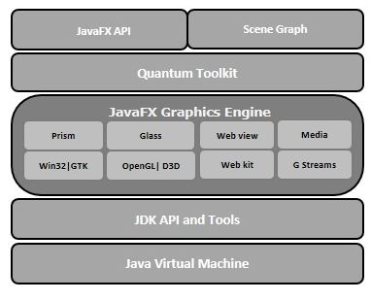
JavaFX - Architecture
javafx.animation − Contains classes to add transition based animations such as fill, fade, rotate, scale and translation, to the JavaFX nodes.
javafx.application − Contains a set of classes responsible for the JavaFX application life cycle.
javafx.css − Contains classes to add CSS–like styling to JavaFX GUI applications.

Slide 7
JavaFX - Architecture
javafx.event − Contains classes and interfaces to deliver and handle JavaFX events.
javafx.geometry − Contains classes to define 2D objects and perform operations on them.
javafx.stage − This package holds the top level container classes for JavaFX application.
javafx.scene − This package provides classes and interfaces to support the scene graph. In addition, it also provides sub-packages such as canvas, chart, control, effect, image, input, layout, media, paint, shape, text, transform, web, etc.

Slide 8
JavaFX Parts
JavaFX has 3 parts
  A GUI builder called SceneBuilder allows drag-and-drop manipulation of widgets.
  A configuration language called FXML that records the widgets in the GUI, their visible attributes and their relationship to each other.
  A Controller class that must be completed by the programmer to bring the GUI to life.
A JavaFX application has some additional parts
  A set of classes to describe the model, which is what the GUI allows the user to interact with.
  A set of cascading style sheets (CSS files) to further specify “look-and-feel”.

Slide 9
JavaFX Scene Builder
JavaFX Scene Builder is a standalone JavaFX GUI visual layout tool that can also be used with various IDEs including Eclipse, NetBeans and IntelliJ.
JavaFX Scene Builder enables you to create GUIs by dragging and dropping GUI components from Scene Builder’s library onto a design area, then modifying and styling the GUI—all without writing any code.
JavaFX Scene Builder generates FXML (FX Markup Language)—an XML vocabulary for defining and arranging JavaFX GUI controls without writing any Java code.

Slide 10
JavaFX Scene Builder
The FXML code is separate from the program logic that’s defined in Java source code—this separation of the interface (the GUI) from the implementation (the Java code) makes it easier to debug, modify and maintain JavaFX GUI apps.
Placing GUI components in a window can be tedious. Being able to do it dynamically using a configuration file makes the job much easier.
No additional compilation is needed unless actions need to be programmed in the Controller.java class.

Slide 11
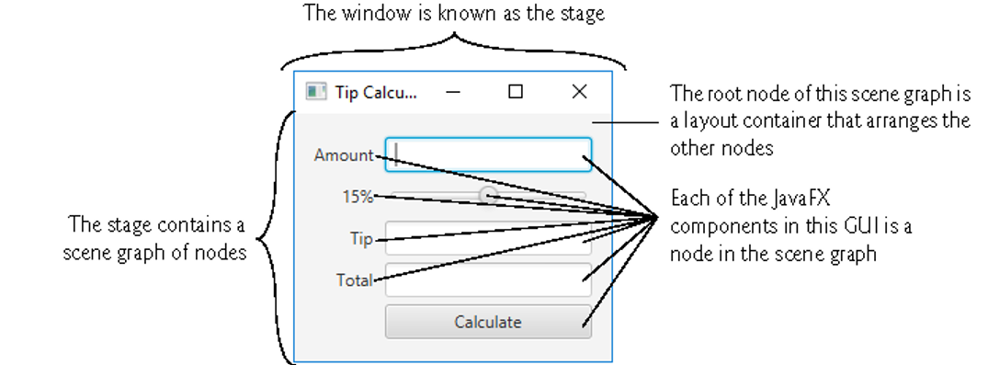
JavaFX App Window Structure

Slide 12
JavaFX App Window Structure
The Stage is the window in which a JavaFX app’s GUI is displayed
  It’s an instance of class Stage (package javafx.stage).
The Stage contains one active Scene that defines the GUI as a scene graph -a tree data structure of an app’s visual elements, such as GUI controls, shapes, images, video, text and.
The scene is an instance of class Scene (package javafx.scene).
Controls are GUI components, such as
  Labels that display text,
  TextFields that enable a program to receive user input,
  Buttons that users click to initiate actions, and more.

Slide 13
JavaFX Application Layout
An application Window in JavaFX is known as a Stage.
  package javafx.stage
A Stage contains an active Scene which is set to a Layout container.
  package javafx.scene
The Scene may have other Layout containers for organizing Controllers in a Tree organization.
  Nodes with children are layout containers.
  Nodes without children are widgets.

Slide 14
JavaFX Application Layout
Each visual element in the scene graph is a node - an instance of a subclass of Node (package javafx.scene), which defines common attributes and behaviors for all nodes
With the exception of the first node in the scene graph - the root node - each node in the scene graph has one parent.
Nodes can have transforms (e.g., moving, rotating and scaling), opacity (whether a node is transparent, partially transparent or opaque), effects (e.g., drop shadows, blurs, reflection and lighting) and more.

Slide 15
JavaFX Application Controls
Nodes with children are typically layout containers that arrange their child nodes in the scene.
  Layout containers contain controls that accept inputs or other layout containers.
When the user interacts with a control, the control generates an event.
Programs can respond to these events—known as event handling—to specify what should happen when each user interaction occurs.
An event handler is a method that responds to a user interaction. An FXML GUI’s event handlers are defined in a so-called controller class.

Slide 16
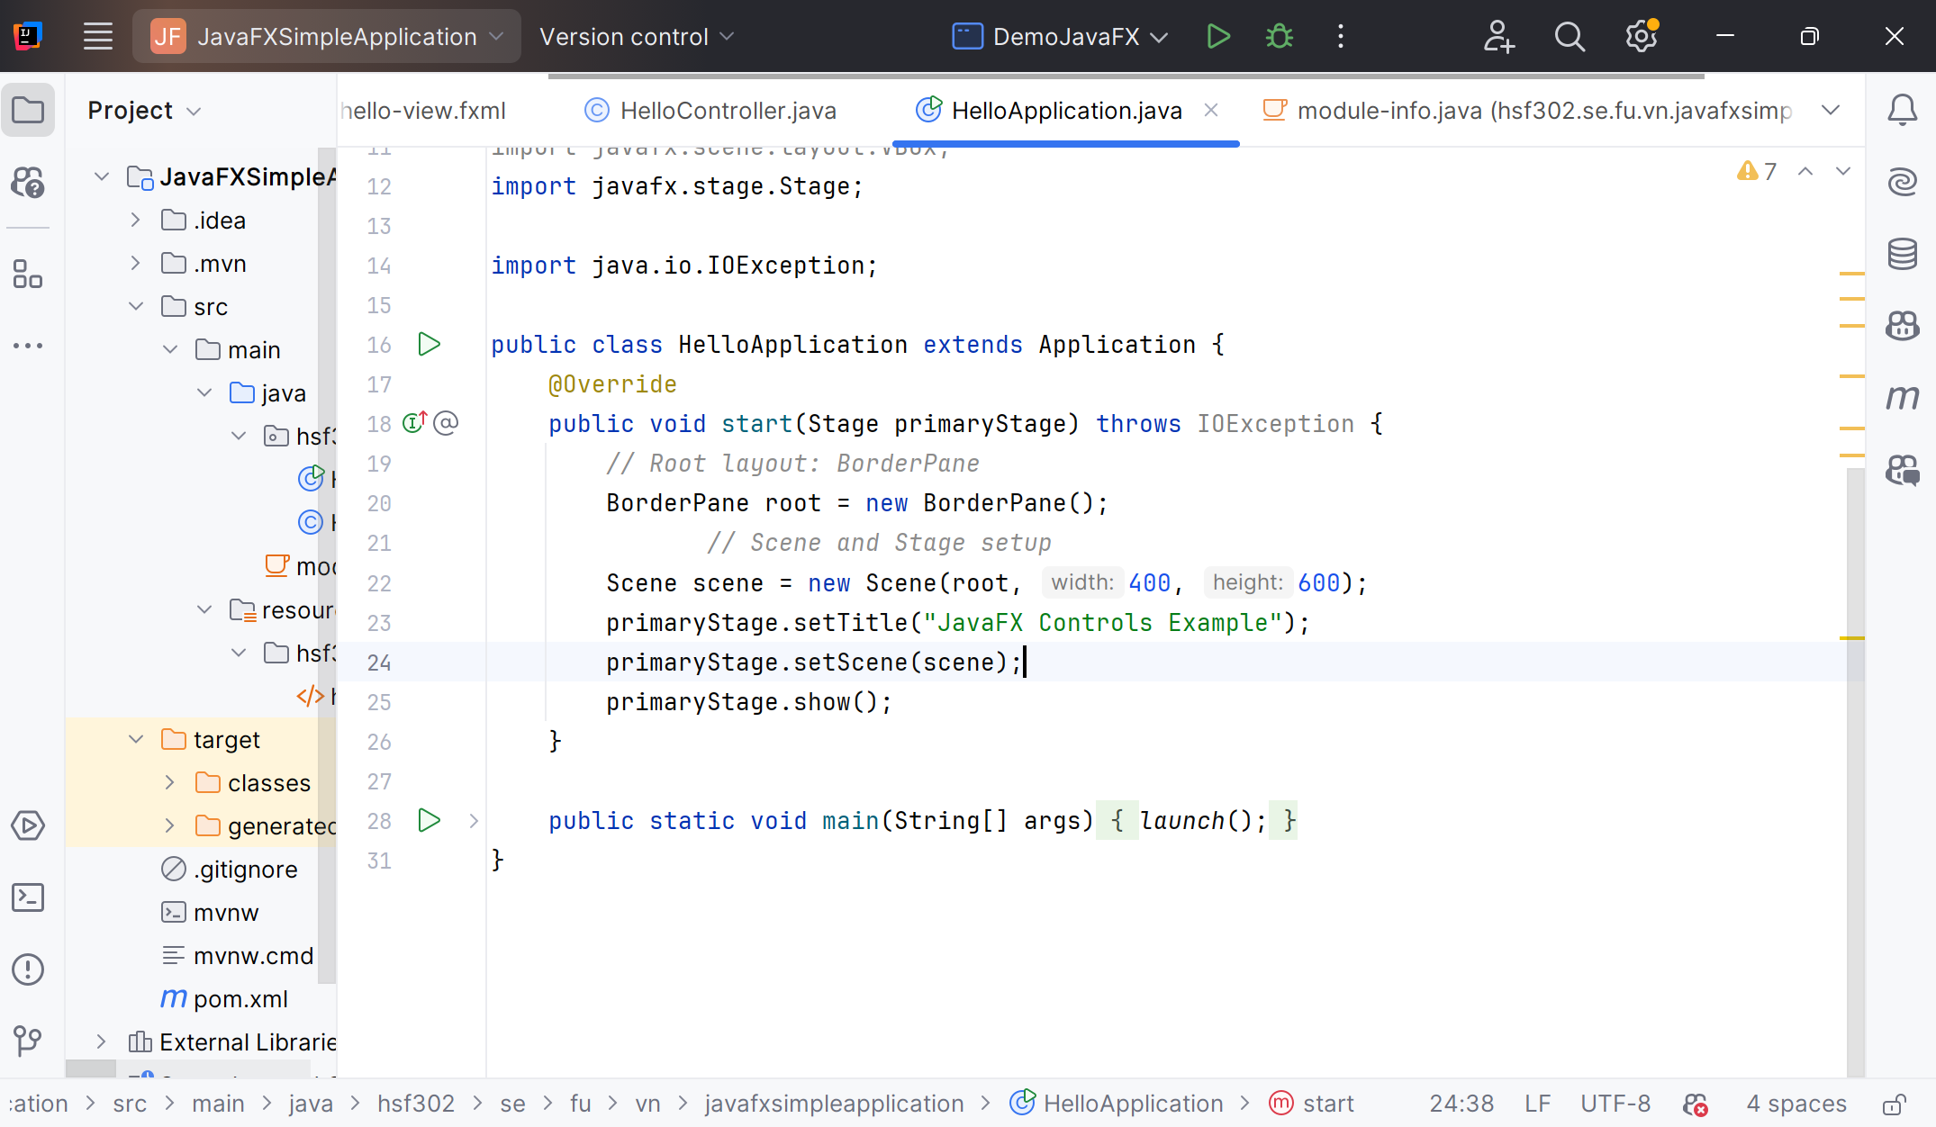
JavaFX Application Class
JavaFX class must implement the abstract start() method of the Application class

Slide 17
JavaFX Core Components, Concepts and Features

Slide 18
Scene to the Stage object
To display something inside the JavaFX application window you must add a Scene to the Stage object.

Slide 19
JavaFX Stage
A JavaFX Stage, javafx.stage.Stage, represents a window in a JavaFX desktop application. Inside a JavaFX Stage, insert a JavaFX Scene which represents the content displayed inside a window - inside a Stage.
Operations:
  Creating a Stage
  Showing a Stage (show() vs. showAndWait())
  Set a Scene on a Stage
  Stage Title
  Stage Position
  Stage Width and Height
  Stage Modality
  Stage Owner
  Stage Style (DECORATED, UNDECORATED, TRANSPARENT, UNIFIED, UTILITY)

Slide 20
JavaFX Scene
The JavaFX Scene object is the root of the JavaFX Scene graph.
JavaFX Scene contains all the visual JavaFX GUI components inside it.
A JavaFX Scene is represented by the class javafx.scene.Scene.
A Scene object has to be set on a JavaFX Stage to be visible.
Operations
  Create Scene
  Set Scene on Stage
  The Scene Graph
  Scene Mouse Cursor

Slide 21
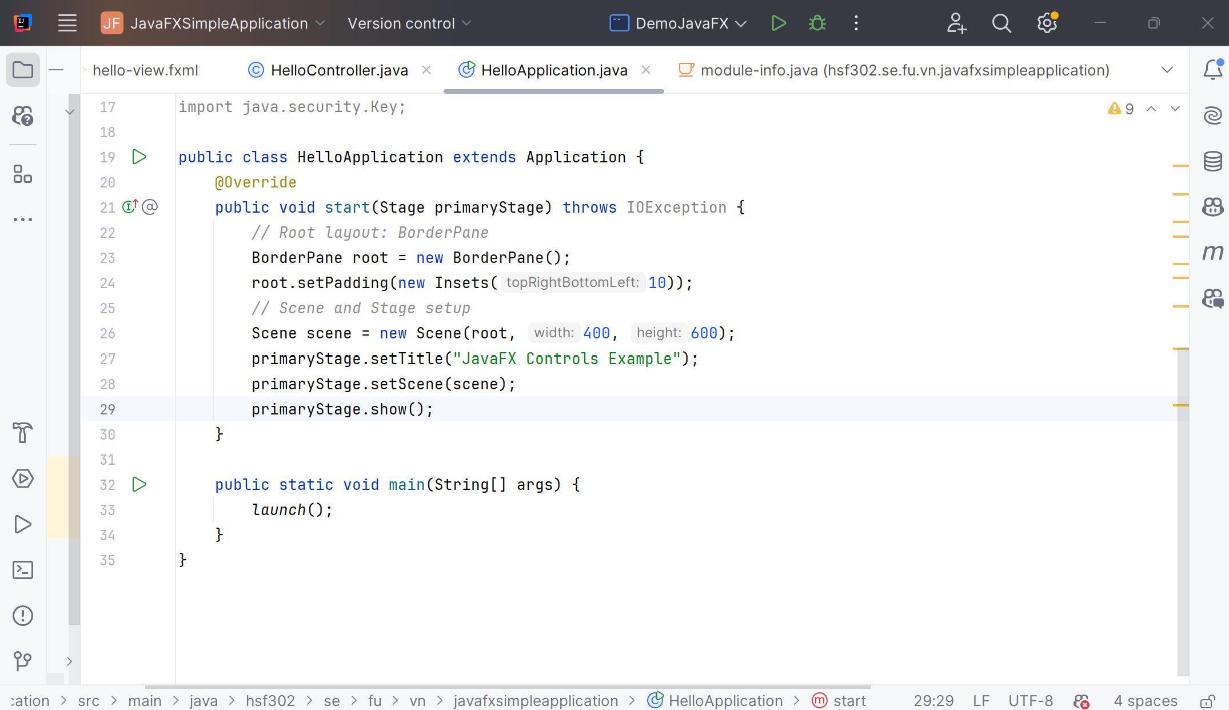
JavaFX Scene
The example shows how to set a specific mouse cursor

Slide 22
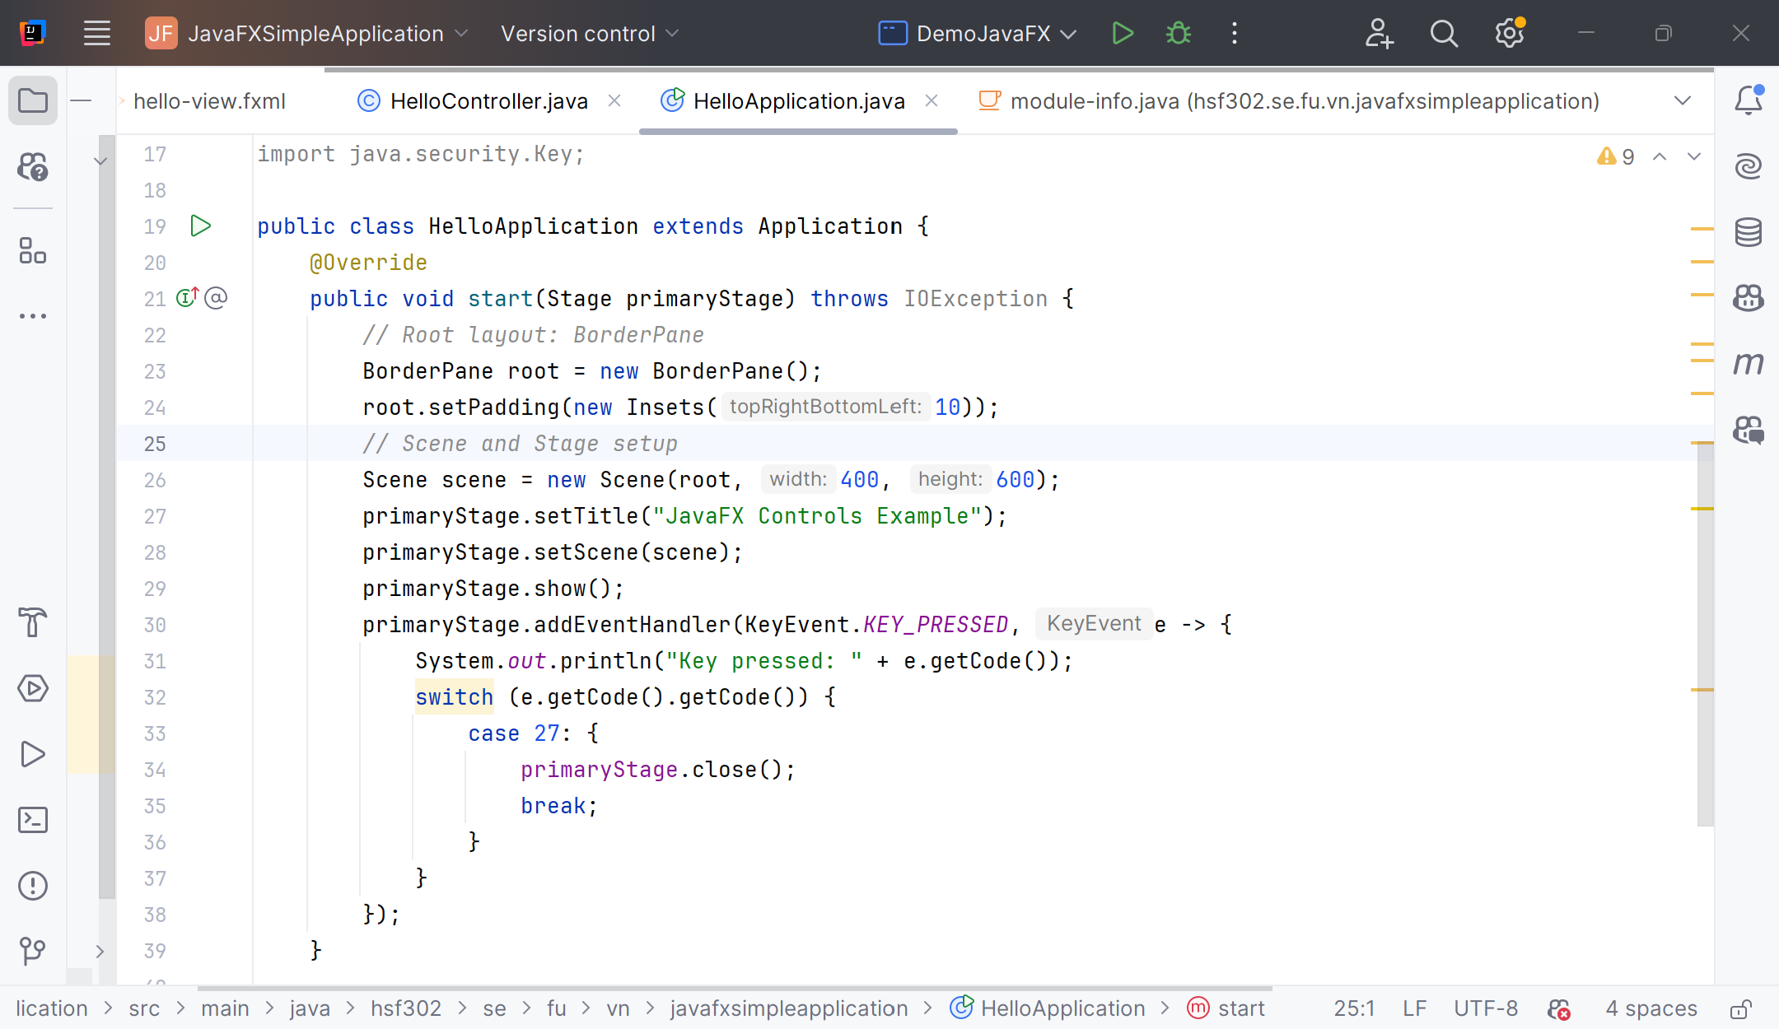
Stage Life Cycle Events
The Stage events: Close Request, Hiding, Hidden, Showing, Shown
Stage keyboard events

Slide 23
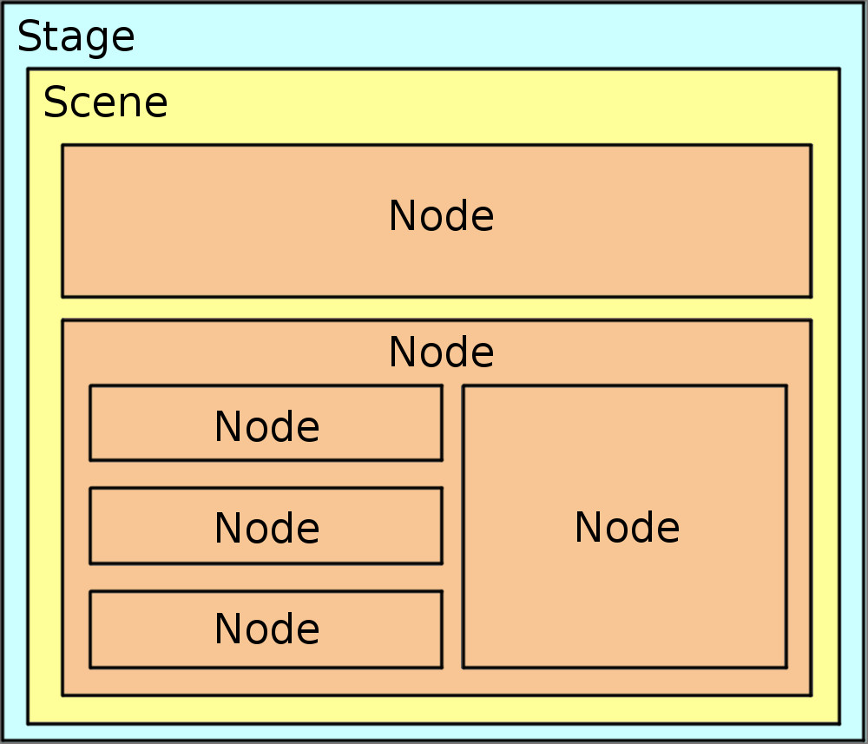
JavaFX Node
Each JavaFX Node (subclass) instance can only be added to the JavaFX scene graph once.
Node instance can only appear in one place in the scene graph.

Slide 24
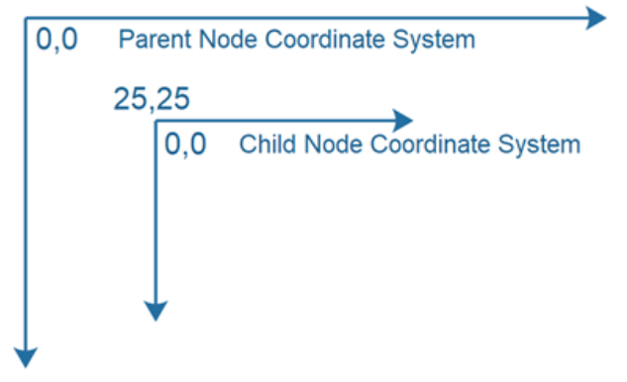
JavaFX Node Properties
A cartesian coordinate system
A bounding box delimited by: Layout bounds, Bounds in local, Bounds in parent
layoutX
layoutY
Preferred height
Preferred width
Minimum height
Minimum width
Maximum height
Maximum width
User data
Items (Child nodes)

Slide 25
JavaFX Properties
A JavaFX Property is a special kind member variable of JavaFX controls.
JavaFX properties are typically used to contain control properties such as X and Y position, width and height, text, children and other central properties of JavaFX controls.
Can attach change listeners to JavaFX properties so other components can get notified when the value of the property changes, and can bind properties to each other so when one property value changes, so does the other.

Slide 26
JavaFX FXML
JavaFX FXML is an XML format that enables you to compose JavaFX GUIs in a fashion similar to how you compose web GUIs in HTML.
FXML enables to separate the JavaFX layout code from the rest of the application code. This cleans up both the layout code and the rest of the application code.
FXML can be used both to compose the layout of a whole application GUI, or just part of an application GUI, e.g. the layout of one part of a form, tab, dialog etc.

Slide 27
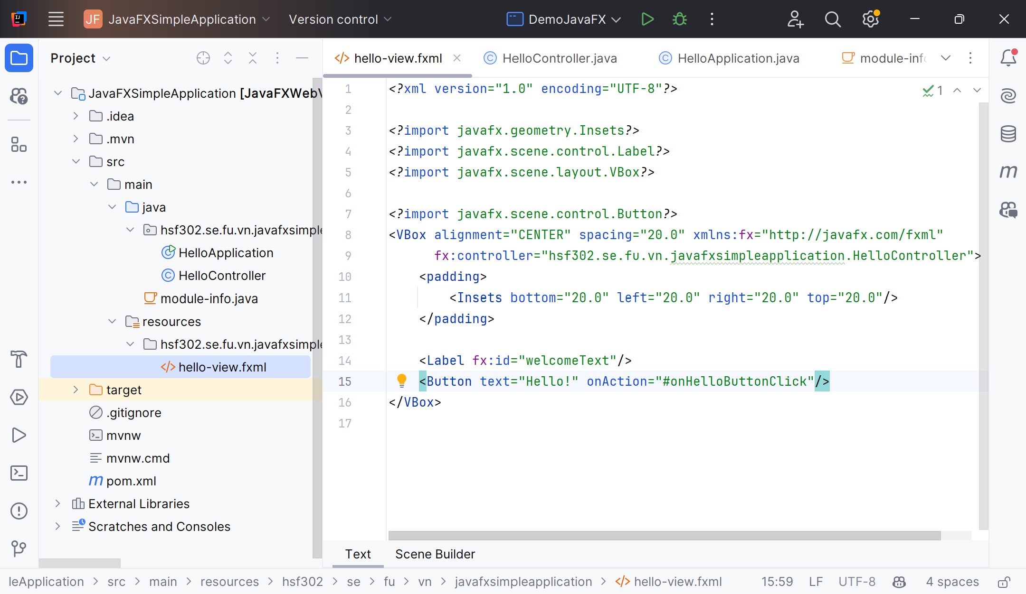
JavaFX FXML

Slide 28
JavaFX Controller

Slide 29
JavaFX Layout, Control Components

Slide 30
JavaFX Layout Components
Layout components to help organize and structure the user interface
JavaFX layouts are components which contains other components inside them. The layout component manages the layout of the components nested inside it.
JavaFX layout components are also sometimes called parent components because they contain child components, and because layout components are subclasses of the JavaFX class javafx.scene.Parent.
Common layout components:
  Group
  Region
  Pane
  VBox and HBox: Arranges its child nodes in a single vertical column or in a single horizontal row.

Slide 31
JavaFX Layout Components
BorderPane: Layout component divides the application window into five regions: top, bottom, left, right, and center.
FlowPane: Arranges its child nodes in a flow that wraps at the boundary of the layout. It is useful for creating dynamically laid out content.
GridPane: Allows for a flexible grid of rows and columns, where child nodes can be placed at specific row and column indices.
StackPane: Layout component stacks its child nodes on top of each other.
AnchorPane: Allows the positioning of nodes relative to the edges of the pane or relative to each other. It is useful for creating precise layouts.
TilePane: Layout its children in a grid of equally sized cells.

Slide 32
JavaFX Controls
JavaFX controls are JavaFX components which provide some kind of control functionality inside a JavaFX application.
For a control to be visible it must be attached to the scene graph of some Scene object.
Controls are usually nested inside some JavaFX layout component that manages the layout of controls relative to each other.

Slide 33
JavaFX Controls
Common JavaFX Controls
  Accordion, Button, CheckBox, ChoiceBox, ColorPicker,
  ComboBox, DatePicker, Label, ListView, Menu, MenuBar, PasswordField
  ProgressBar, RadioButton, Slider, Spinner, SplitMenuButton, TableView
  TextArea, TextField, ToggleButton, ToolBar, TreeTableView, TreeView

Slide 34
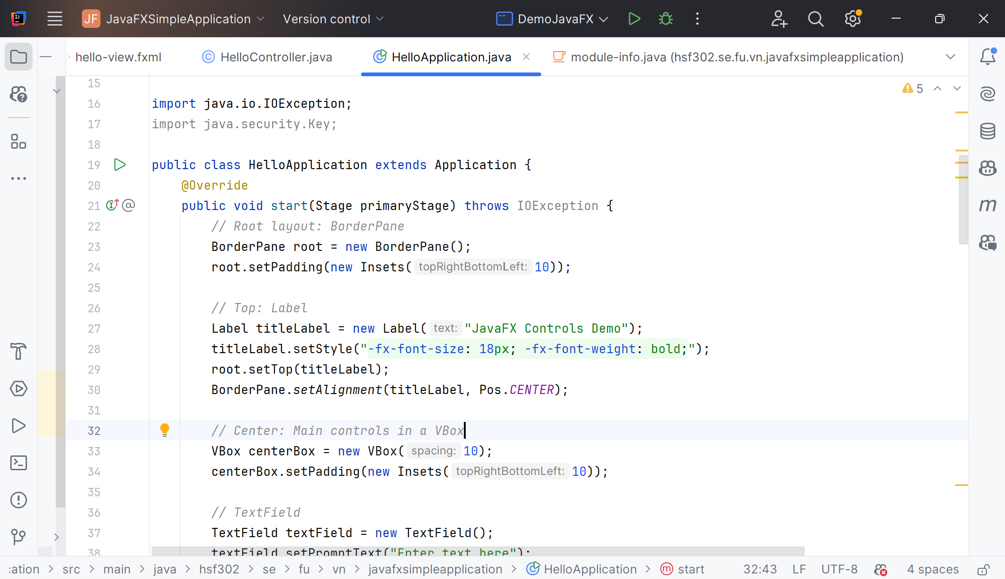
Example : BorderPane

Slide 35
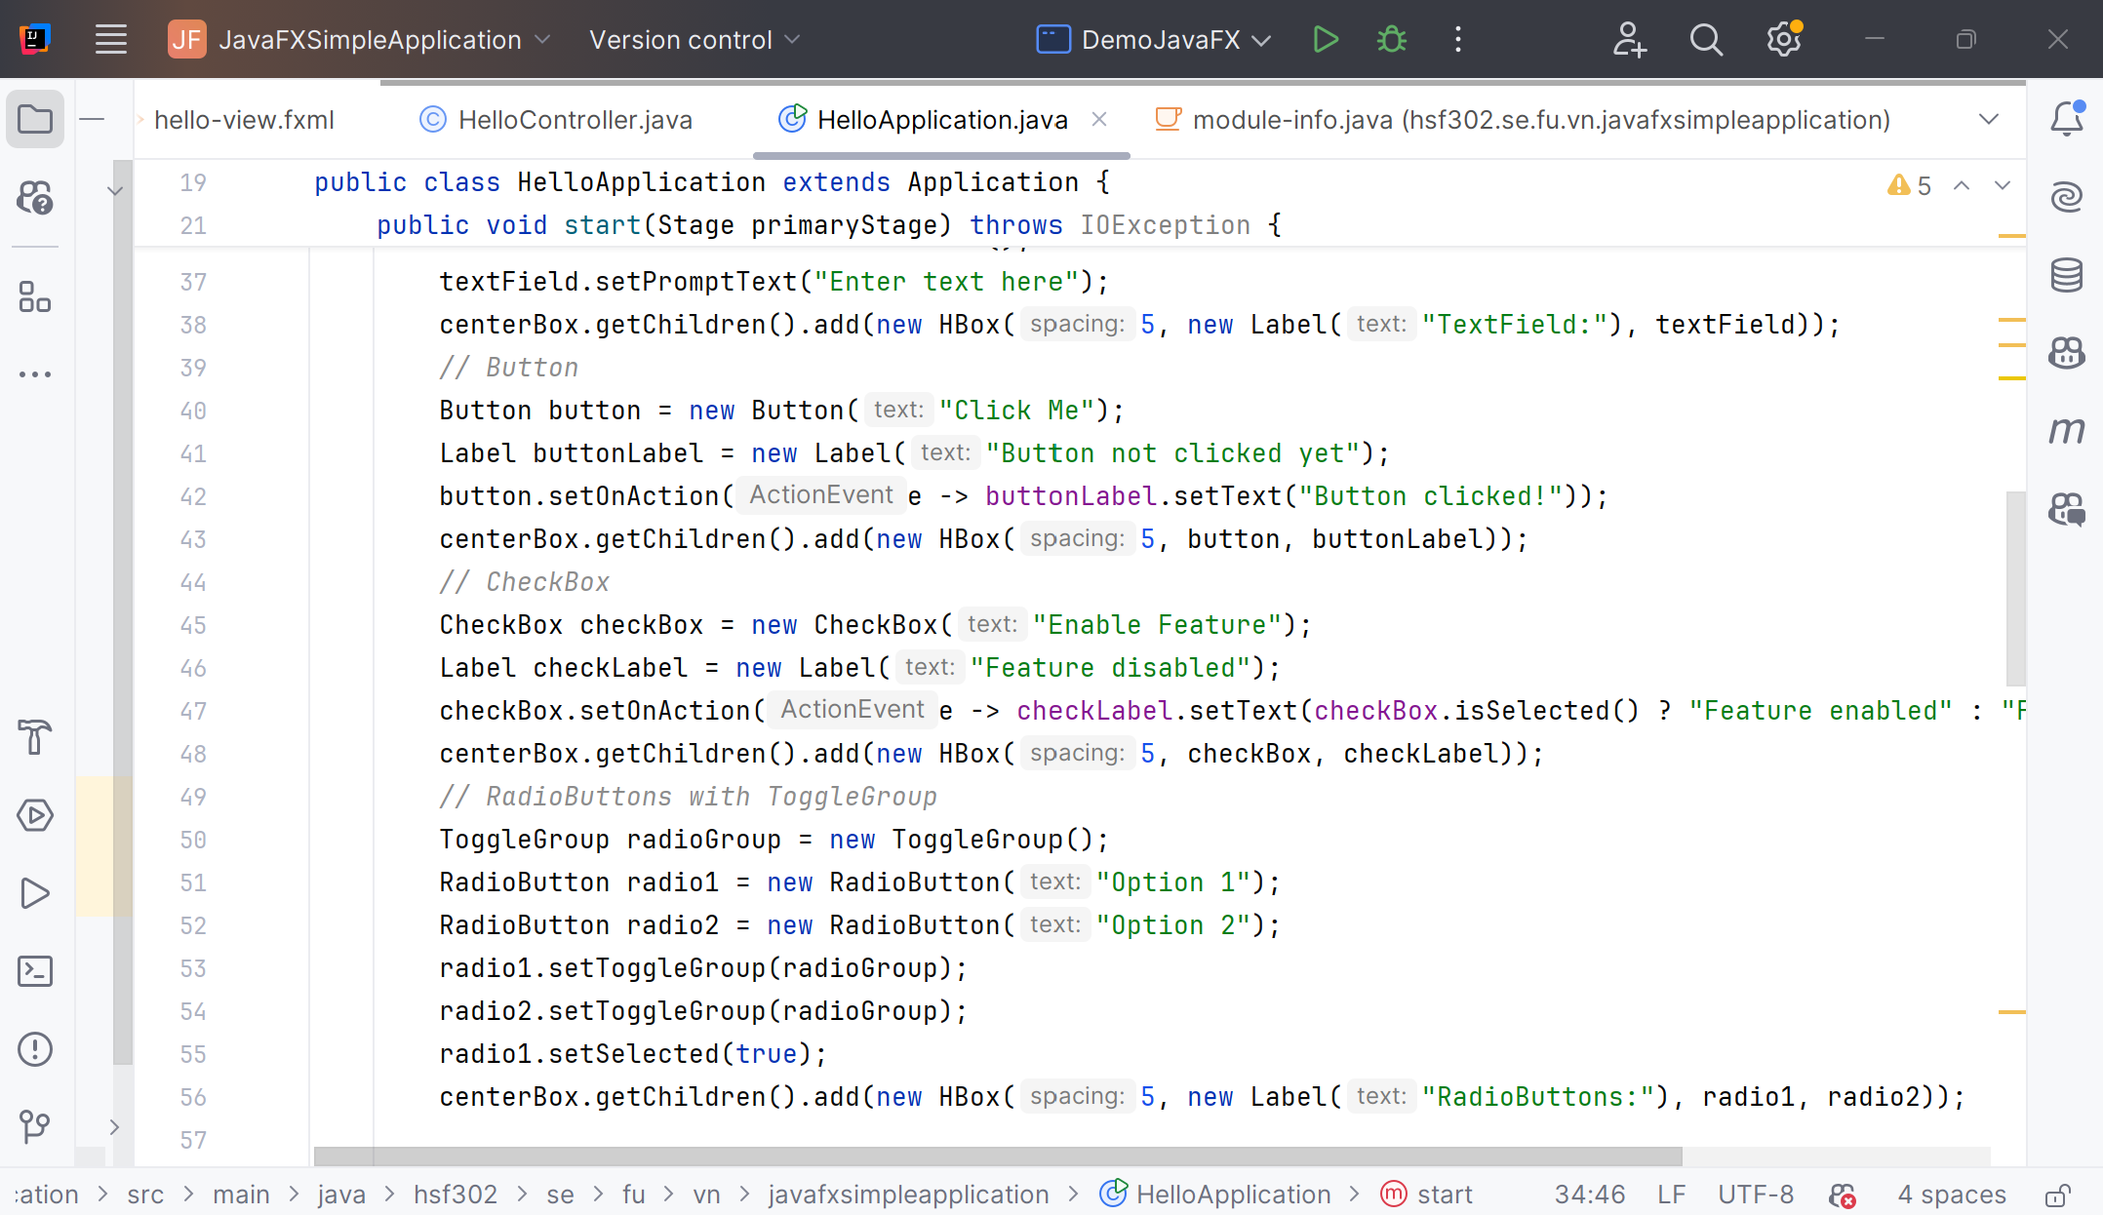
Example : Button

Slide 36
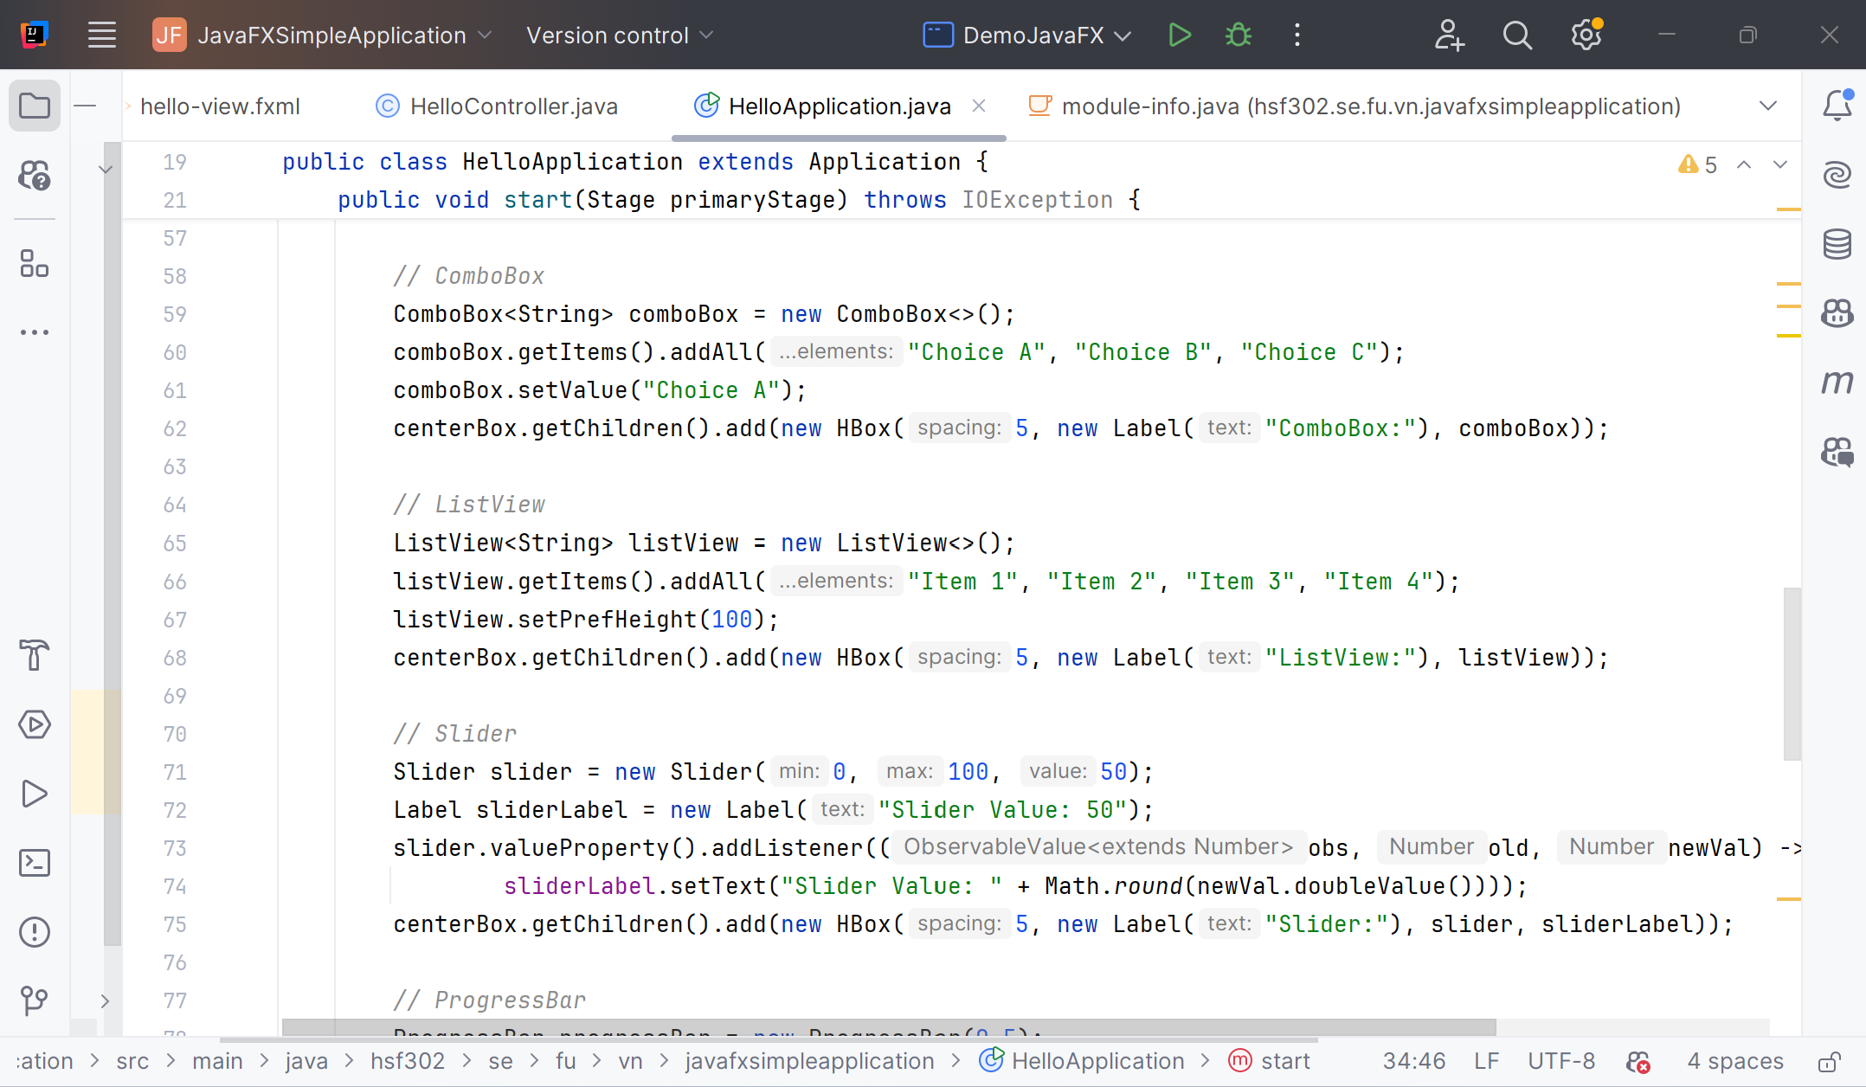
Example : Combobox

Slide 37
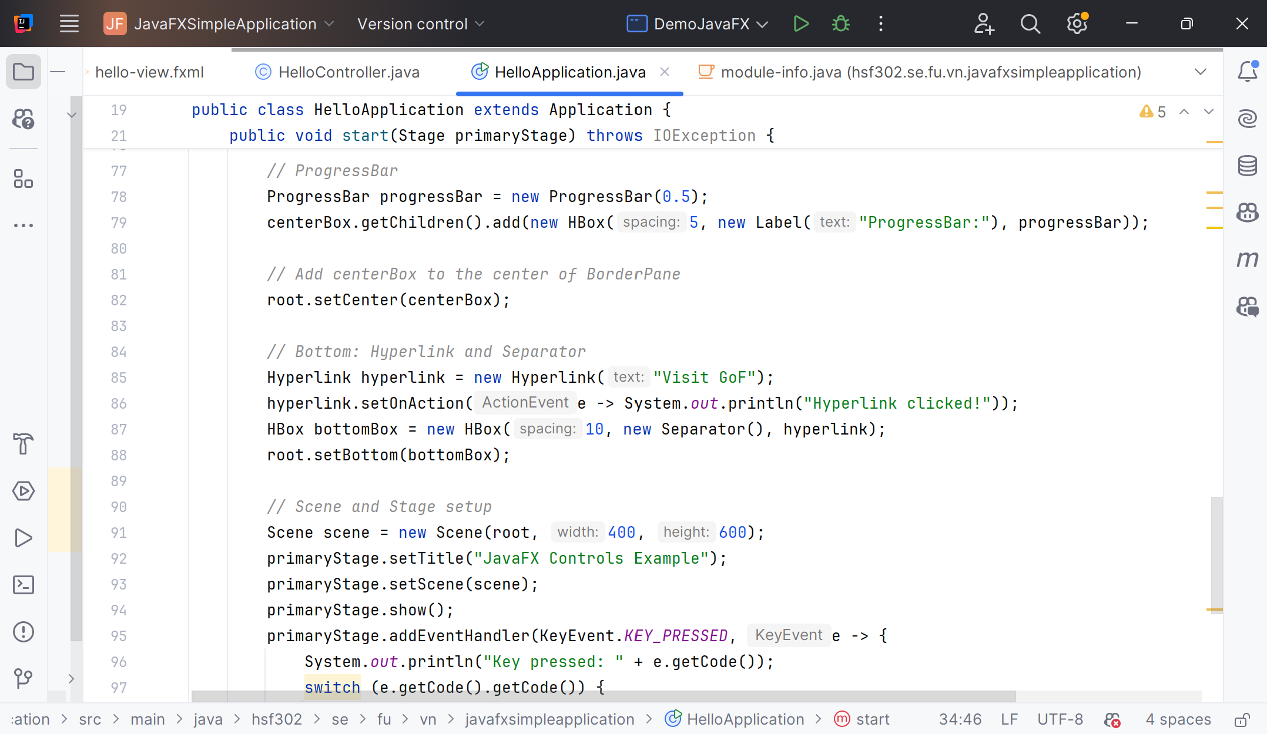
Example : ProgressBar

Slide 38
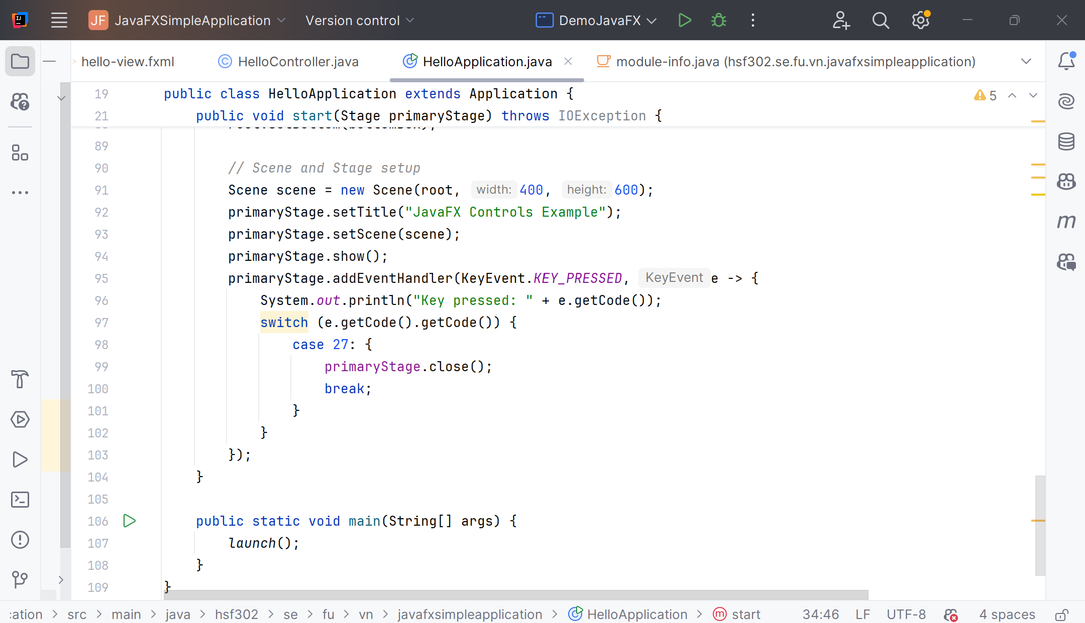
Example : Close

Slide 39
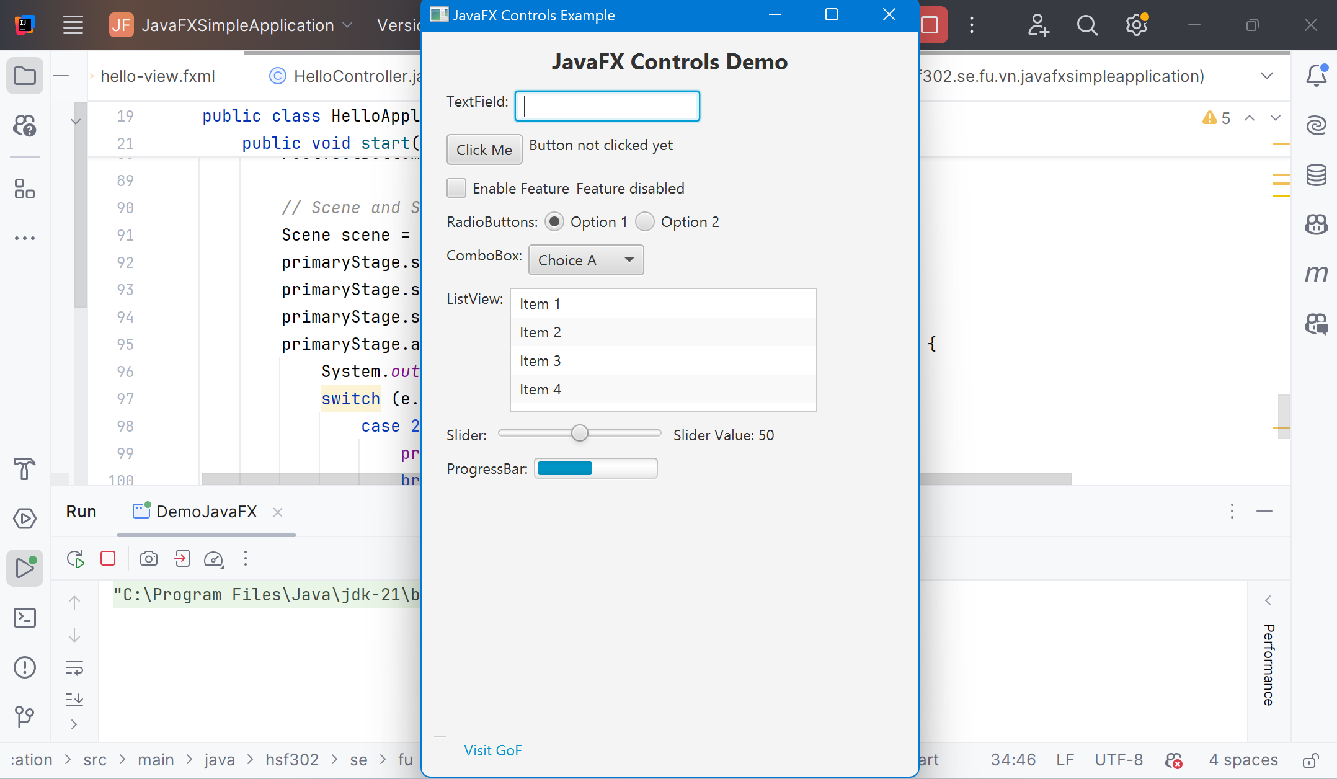
Result

Slide 40
JavaFX 2D Graphics
JavaFX contains features that makes it easy to draw 2D graphics on the screen.
2D shape is represented by a class and all these classes belongs to the package javafx.scene.shape.
Predefined shapes such as Line, Rectangle, Circle, Ellipse, Polygon, Polyline, Cubic Curve, Quad Curve, Arc.
Path elements such as MoveTO Path Element, Line, Horizontal Line, Vertical Line, Cubic Curve, Quadratic Curve, Arc.
In addition to these, you can also draw a 2D shape by parsing SVG path.

Slide 41
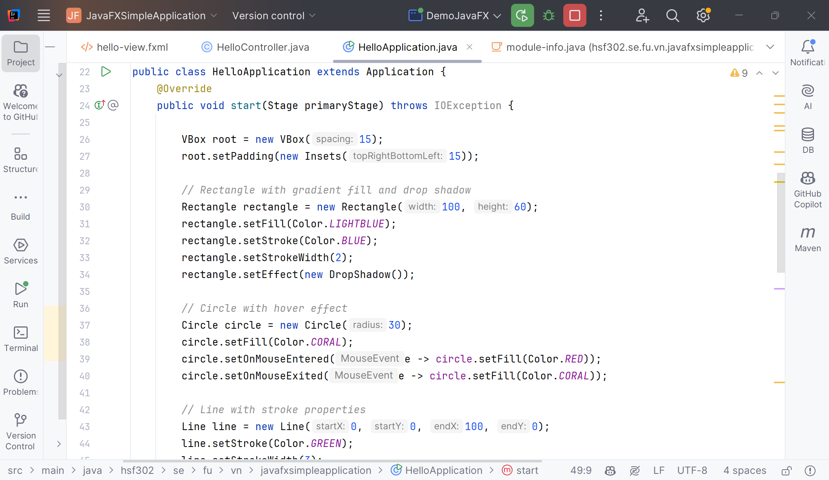
Example 2D Graphics

Slide 42
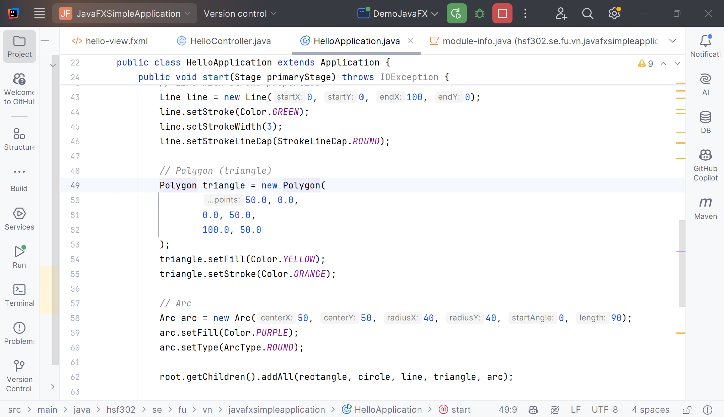
Example 2D Graphics

Slide 43
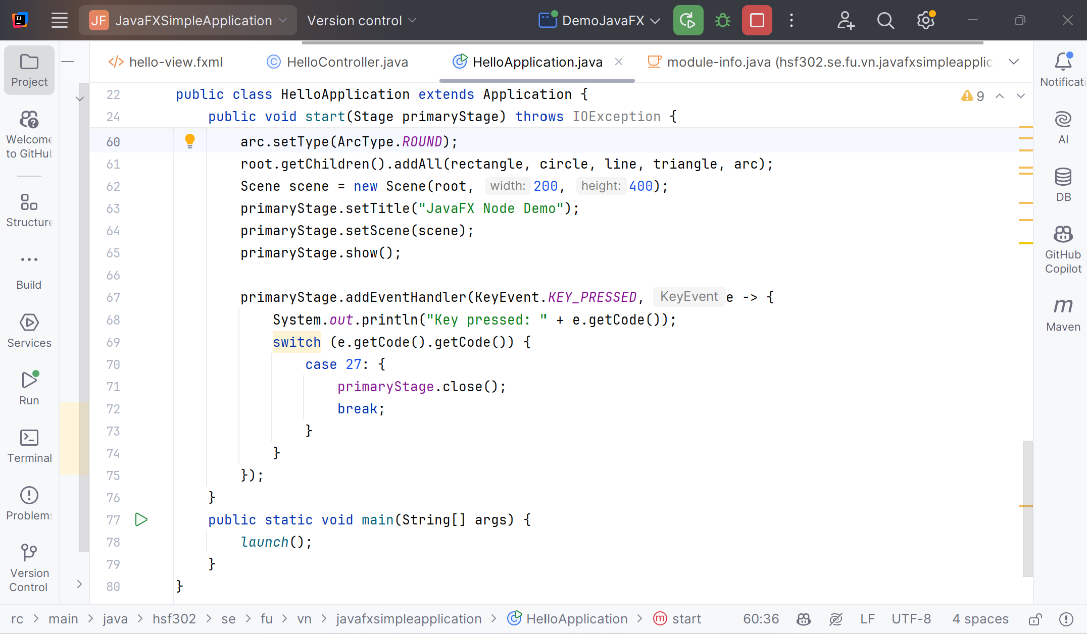
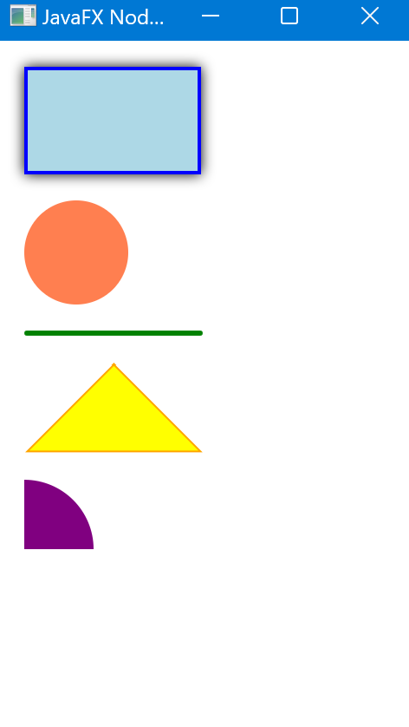
Example 2D Graphics

Slide 44
JavaFX 3D Graphics
JavaFX contains features that makes it easy to draw 3D graphics on the screen.
In general, a 3D shape is a geometrical figure that can be drawn on the XYZ plane.
They are defined by two or more dimensions, commonly length, width and depth.
3D shapes supported by JavaFX include a Cylinder, Sphere and a Box.
All 3D shape classes belong to the package javafx.scene.shape.

Slide 45
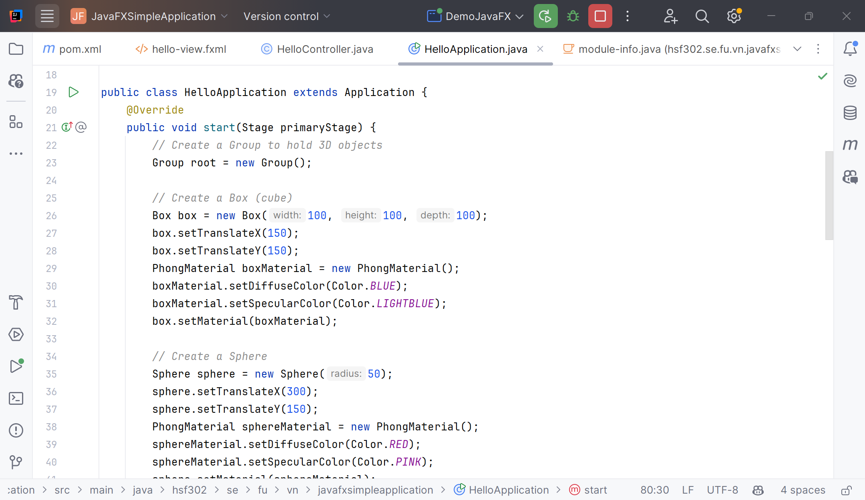
Example 3D Graphics

Slide 46
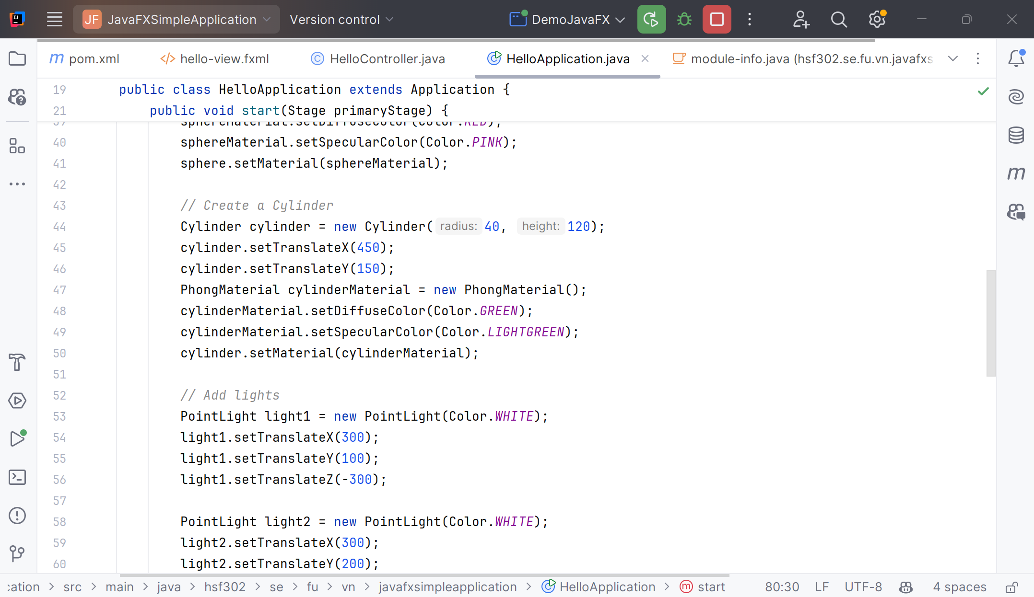
Example 3D Graphics

Slide 47
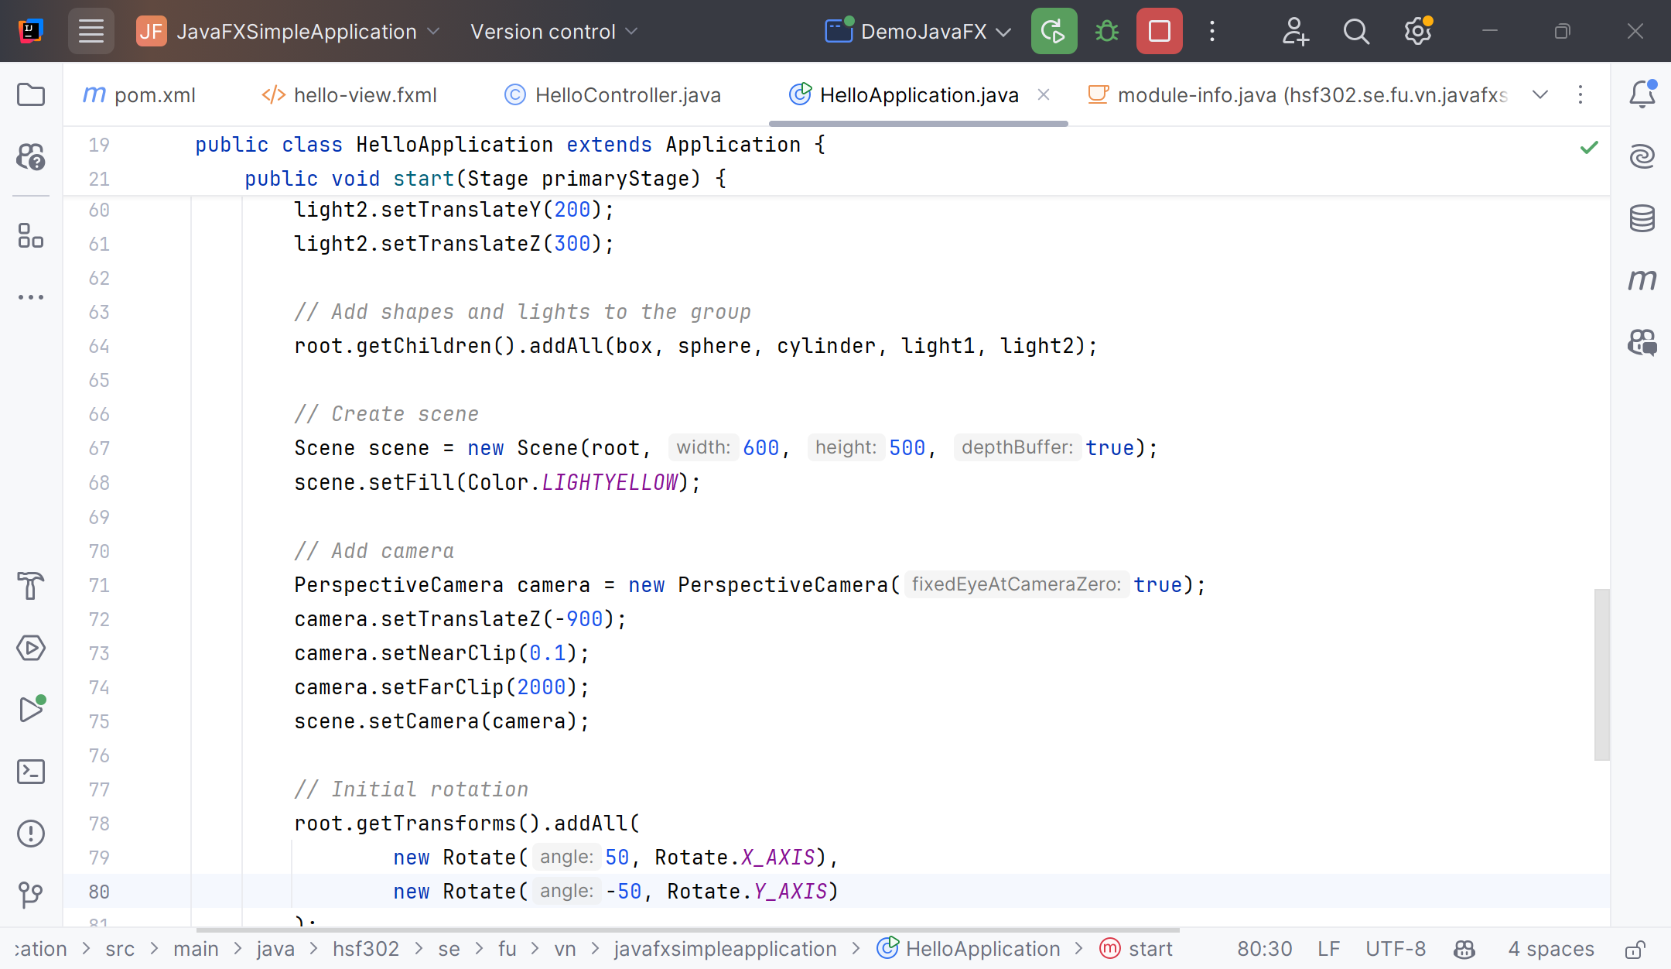
Example 3D Graphics

Slide 48
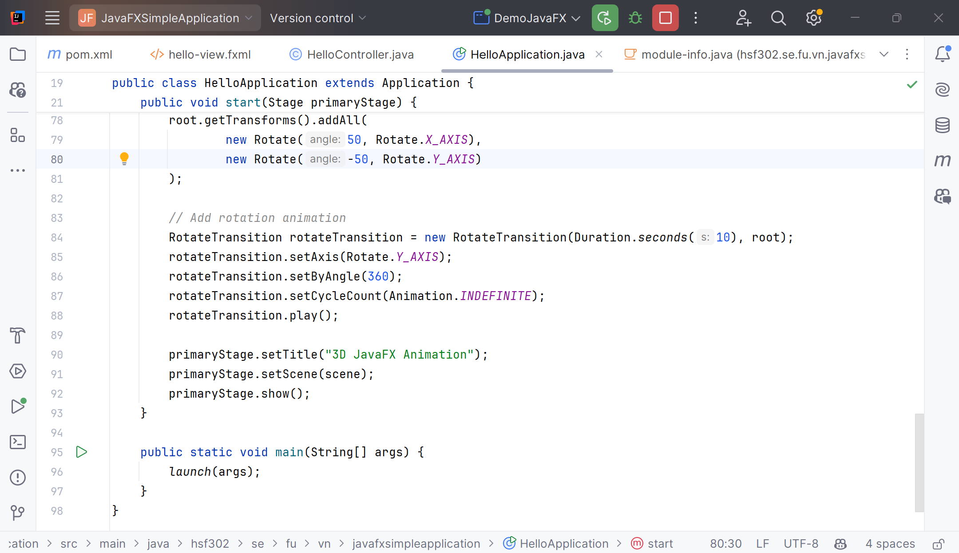
Example 3D Graphics

Slide 49
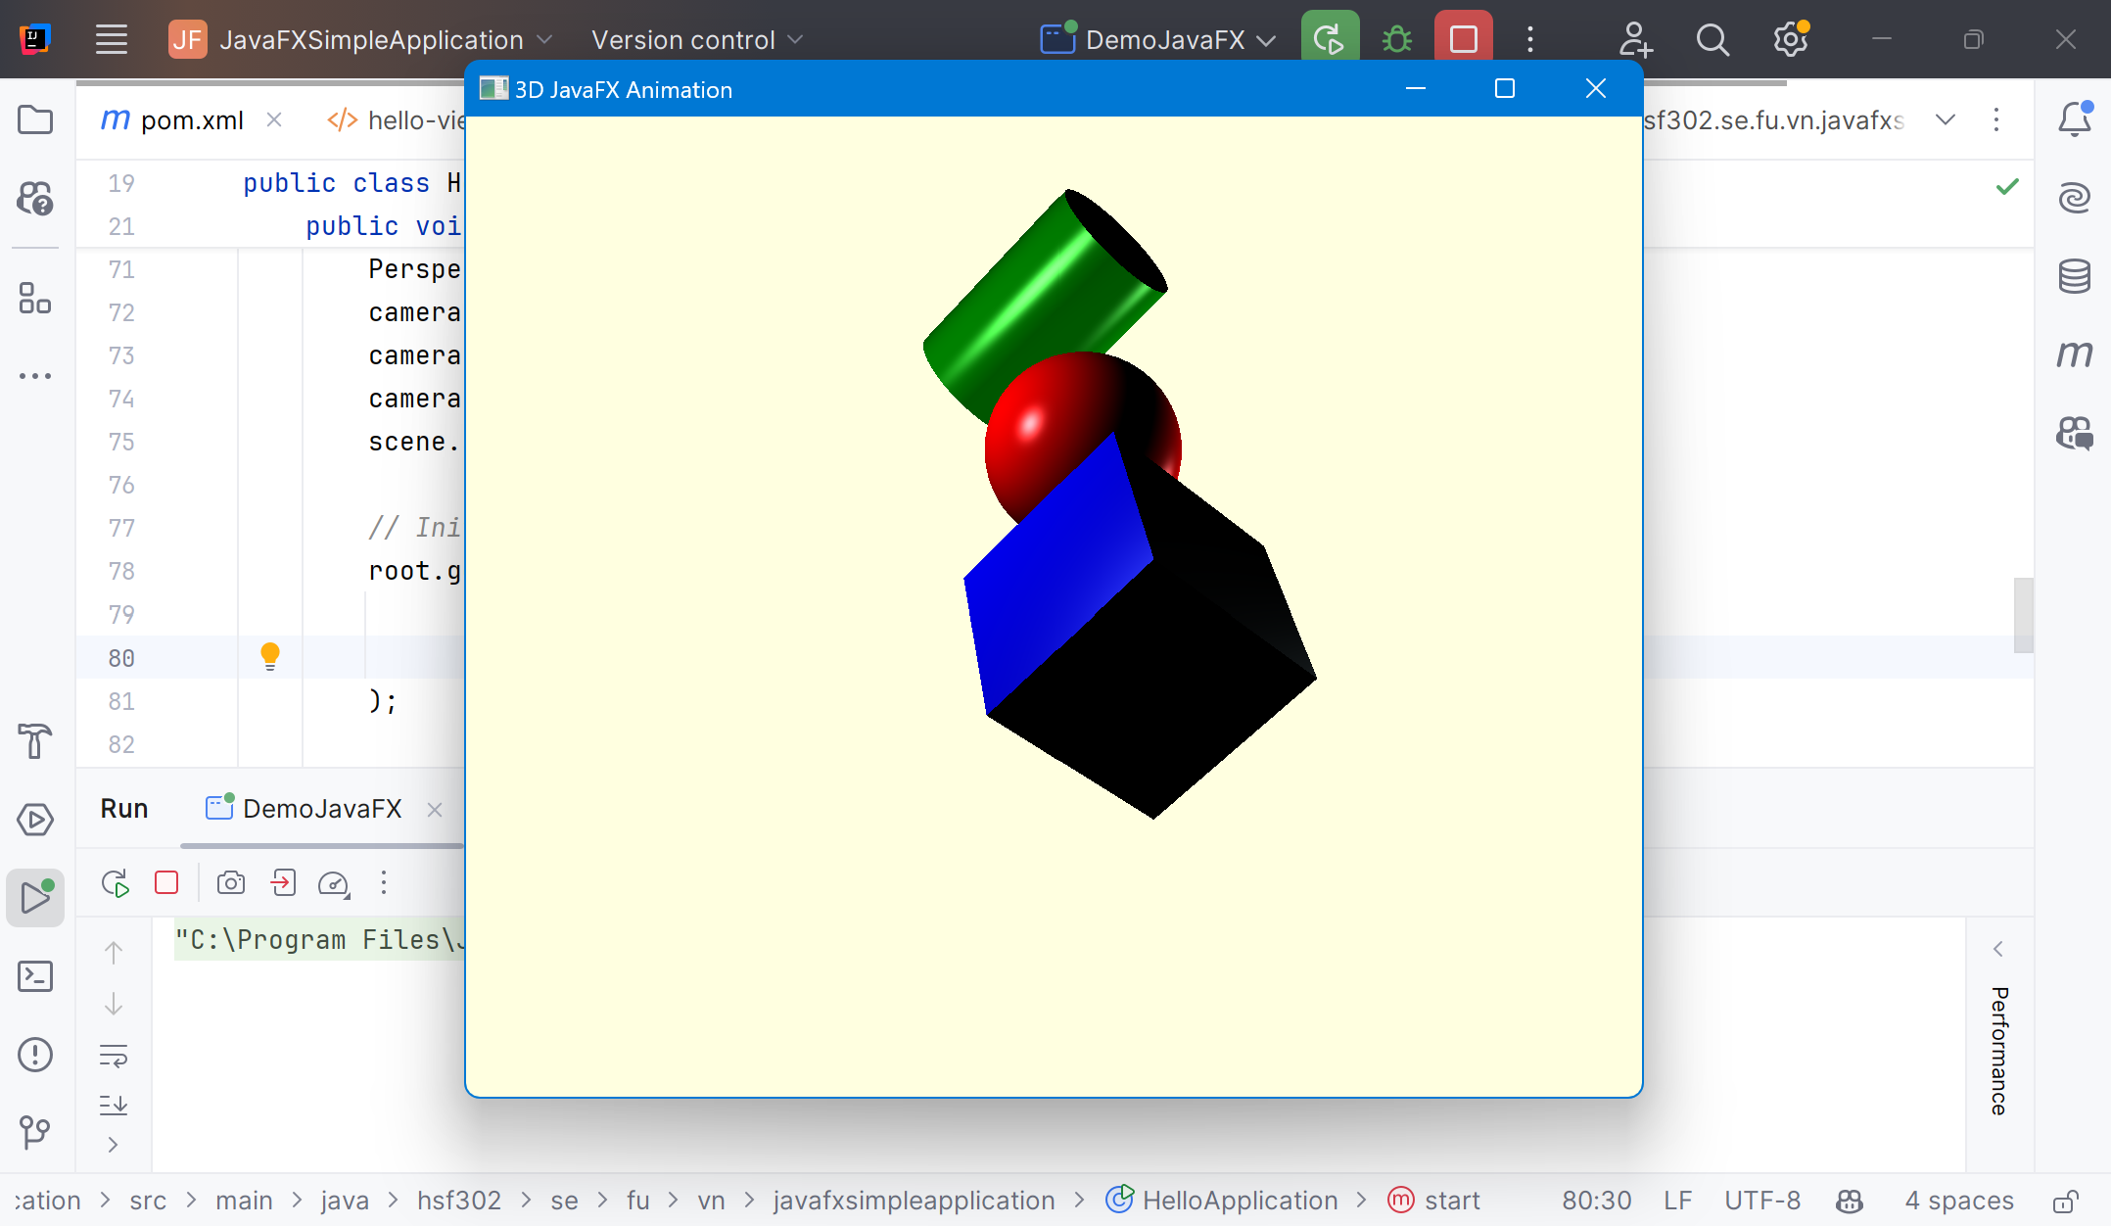
Example 3D Graphics

Slide 50
JavaFX Audio, Video
JavaFX contains features that makes it easy to play audio, video in JavaFX applications.
The package javafx.scene.media contains the classes and interfaces to provide media functionality in JavaFX.
It is provided in the form of three components
  Media Object − This represents a media file
  Media Player − To play media content.
  Media View − To display media.

Slide 51
JavaFX WebView
The JavaFX WebView (javafx.scene.web.WebView) component is capable of showing web pages (HTML, CSS, SVG, JavaScript) inside a JavaFX application. As such, the JavaFX WebView is a mini browser.
The JavaFX WebView uses the WebKit open source browser engine internally to render the web pages.
The JavaFX WebView WebEngine (javafx.scene.web.WebEngine) is an internal component used by the WebView to load the data that is to be displayed inside the WebView.
To make the WebView WebEngine load data, you must first obtain the WebEngine instance from the WebView.

Slide 52
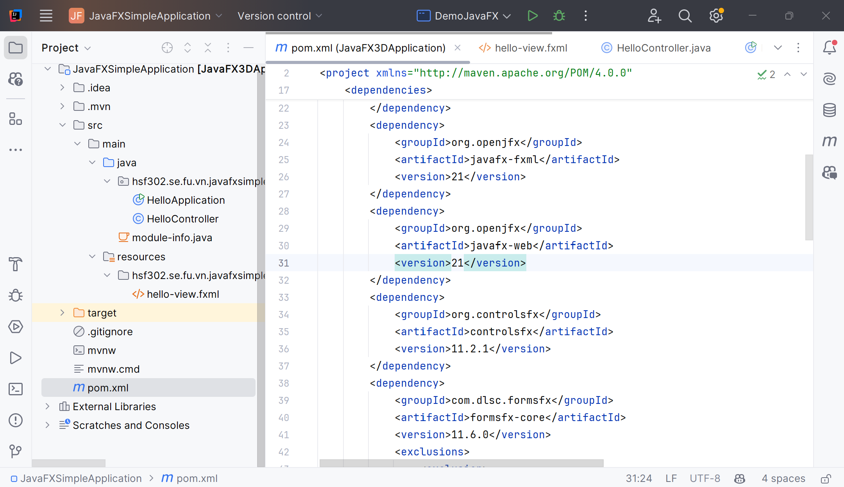
Update pom.xml

Slide 53
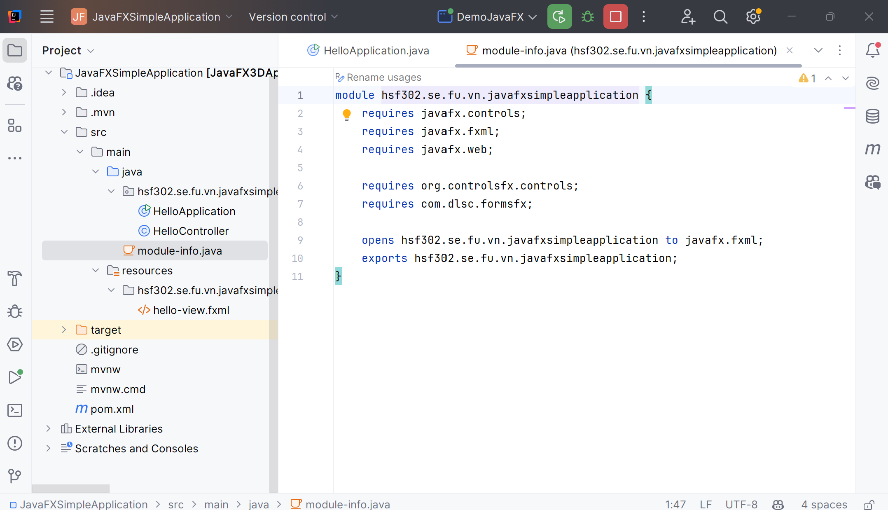
Update module-info.java

Slide 54
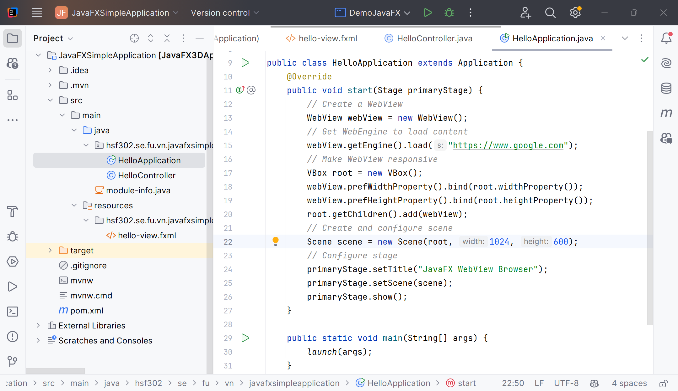
Update main.java

Slide 55
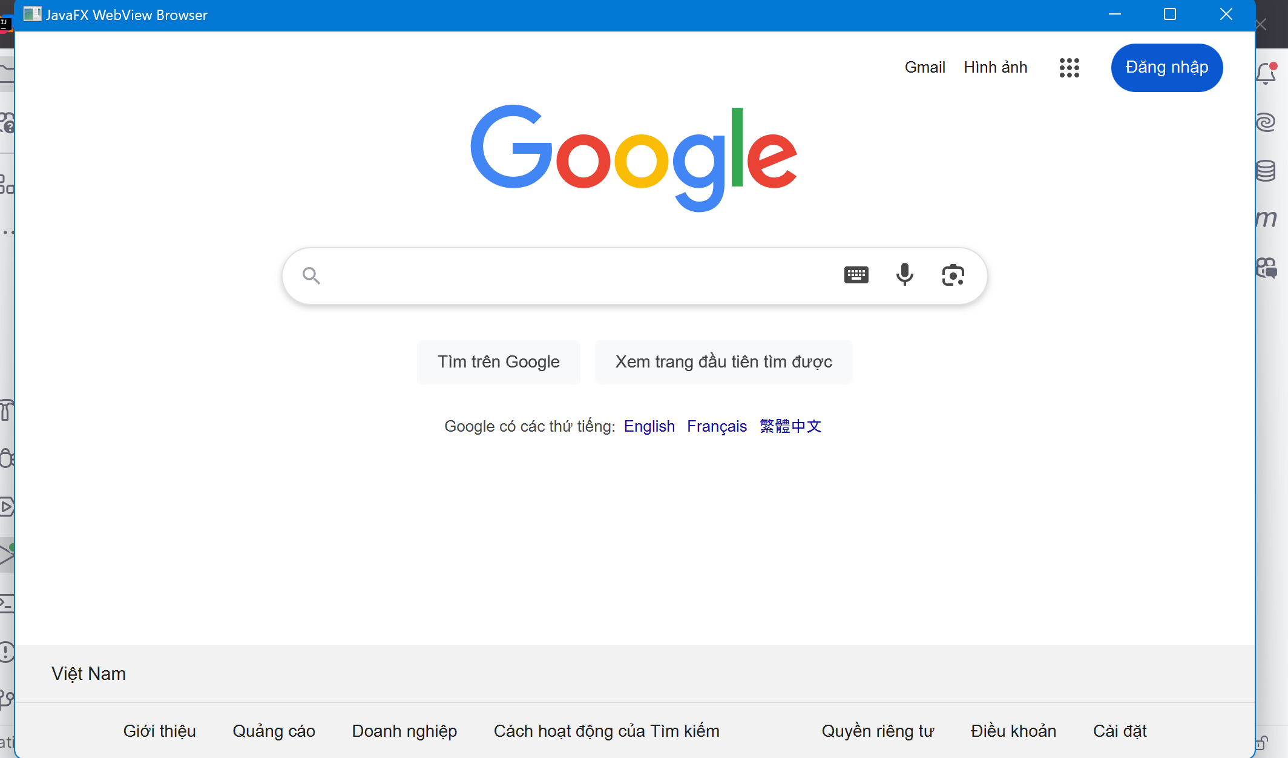
JavaFX WebView

Slide 56
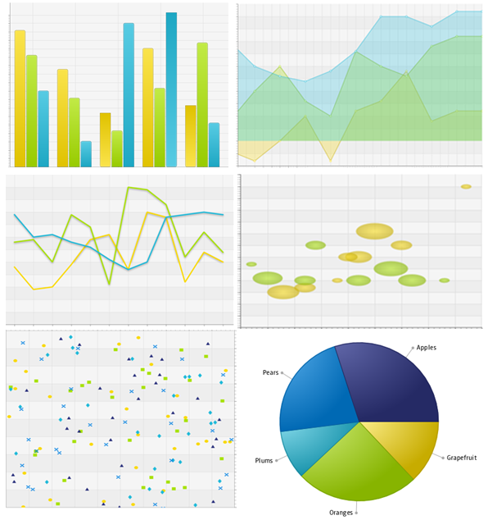
JavaFX Charts
The JavaFX charts available in the javafx.scene.chart package.
AreaChart
BarChart
BubbleChart
LineChart
PieChart
ScatterChart
StackedAreaChart
StackedBarChart

Slide 57
JavaFX Charts
The JavaFX PieChart component is capable of drawing pie charts in your JavaFX application based on data you supply it.
The PieChart component is really easy to use.
The JavaFX PieChart component is represented by the class javafx.scene.chart.PieChart.

Slide 58
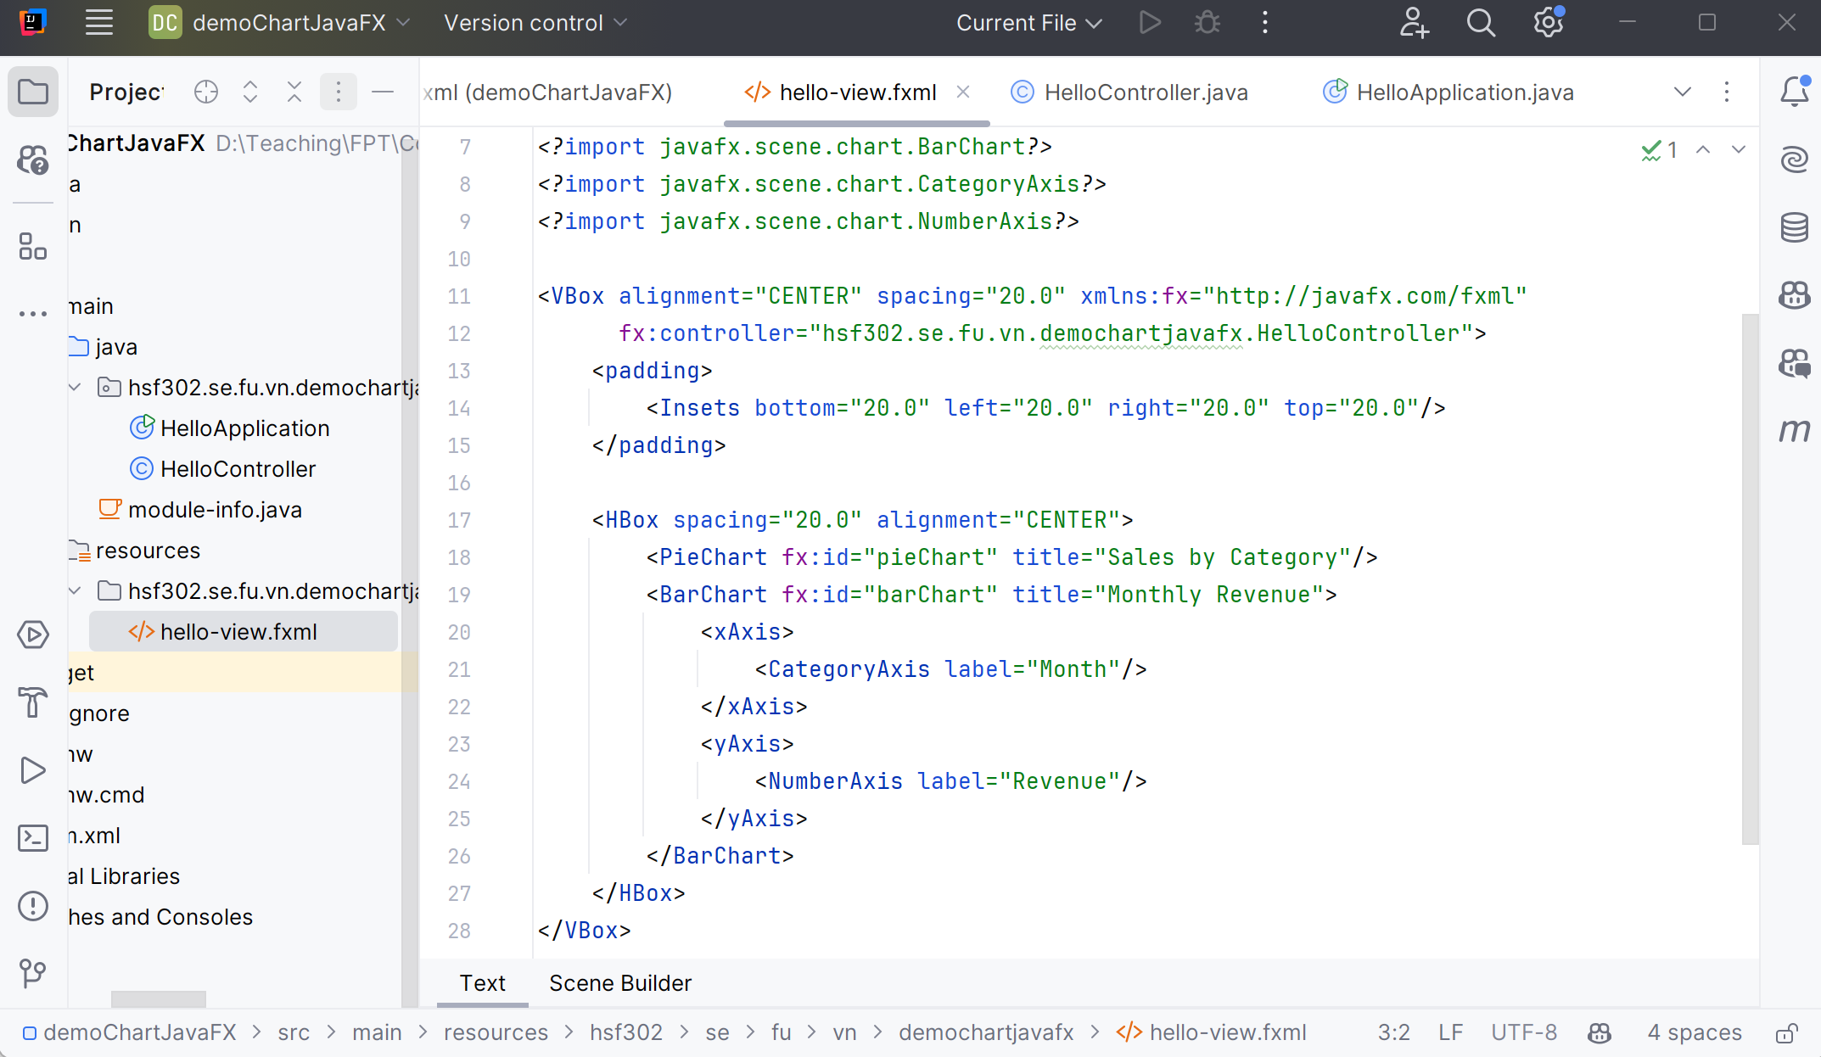
View of JavaFX Charts

Slide 59
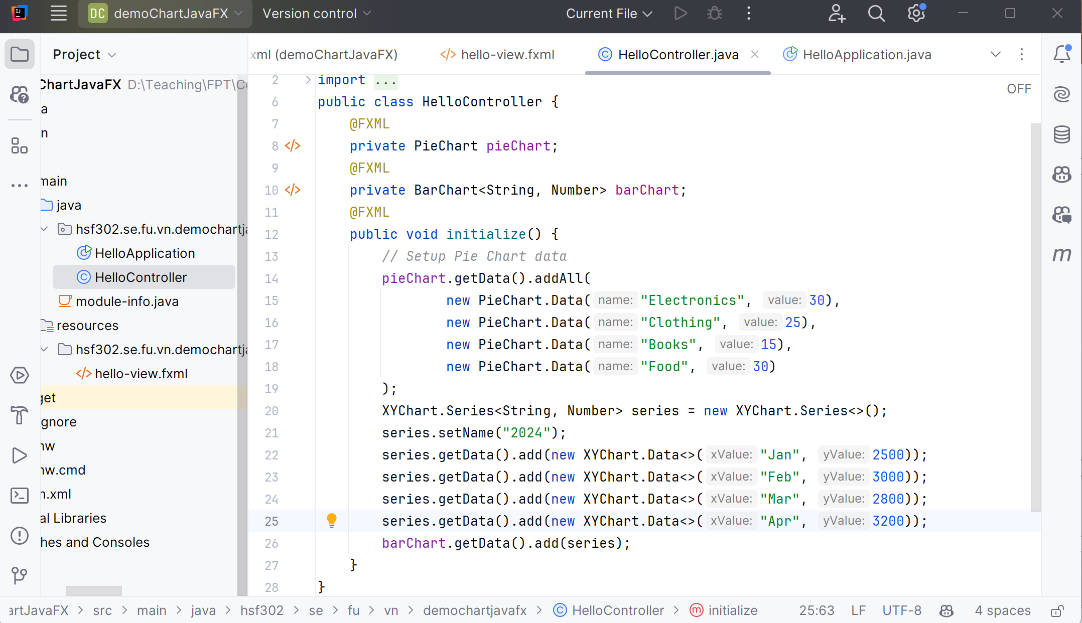
Controller of JavaFX Charts

Slide 60
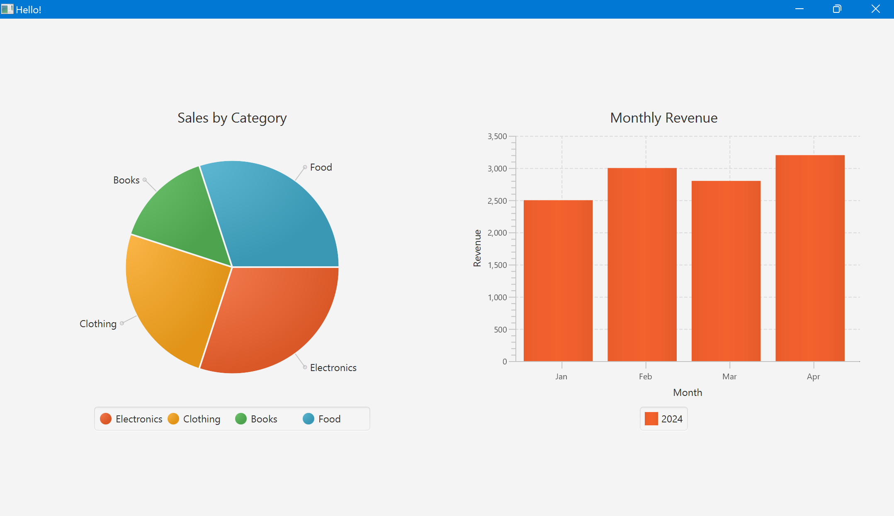
JavaFX Chart

Slide 61
JavaFX Concurrency
JavaFX concurrency refers to how JavaFX is designed with respect to multithreading and concurrency.
JavaFX uses a single-threaded rendering design, meaning only a single thread can render anything on the screen, and that is the JavaFX application thread. In fact, only the JavaFX application thread is allowed to make any changes to the JavaFX Scene Graph in general.
A single-threaded rendering design is easier to implement correctly, but long-running tasks that run within the JavaFX application thread make the GUI unresponsive until the task is completed. No JavaFX GUI controls react to mouse clicks, mouse over, keyboard input while the JavaFX application thread is busy running that task.

Slide 62
JavaFX Demonstration

Slide 63
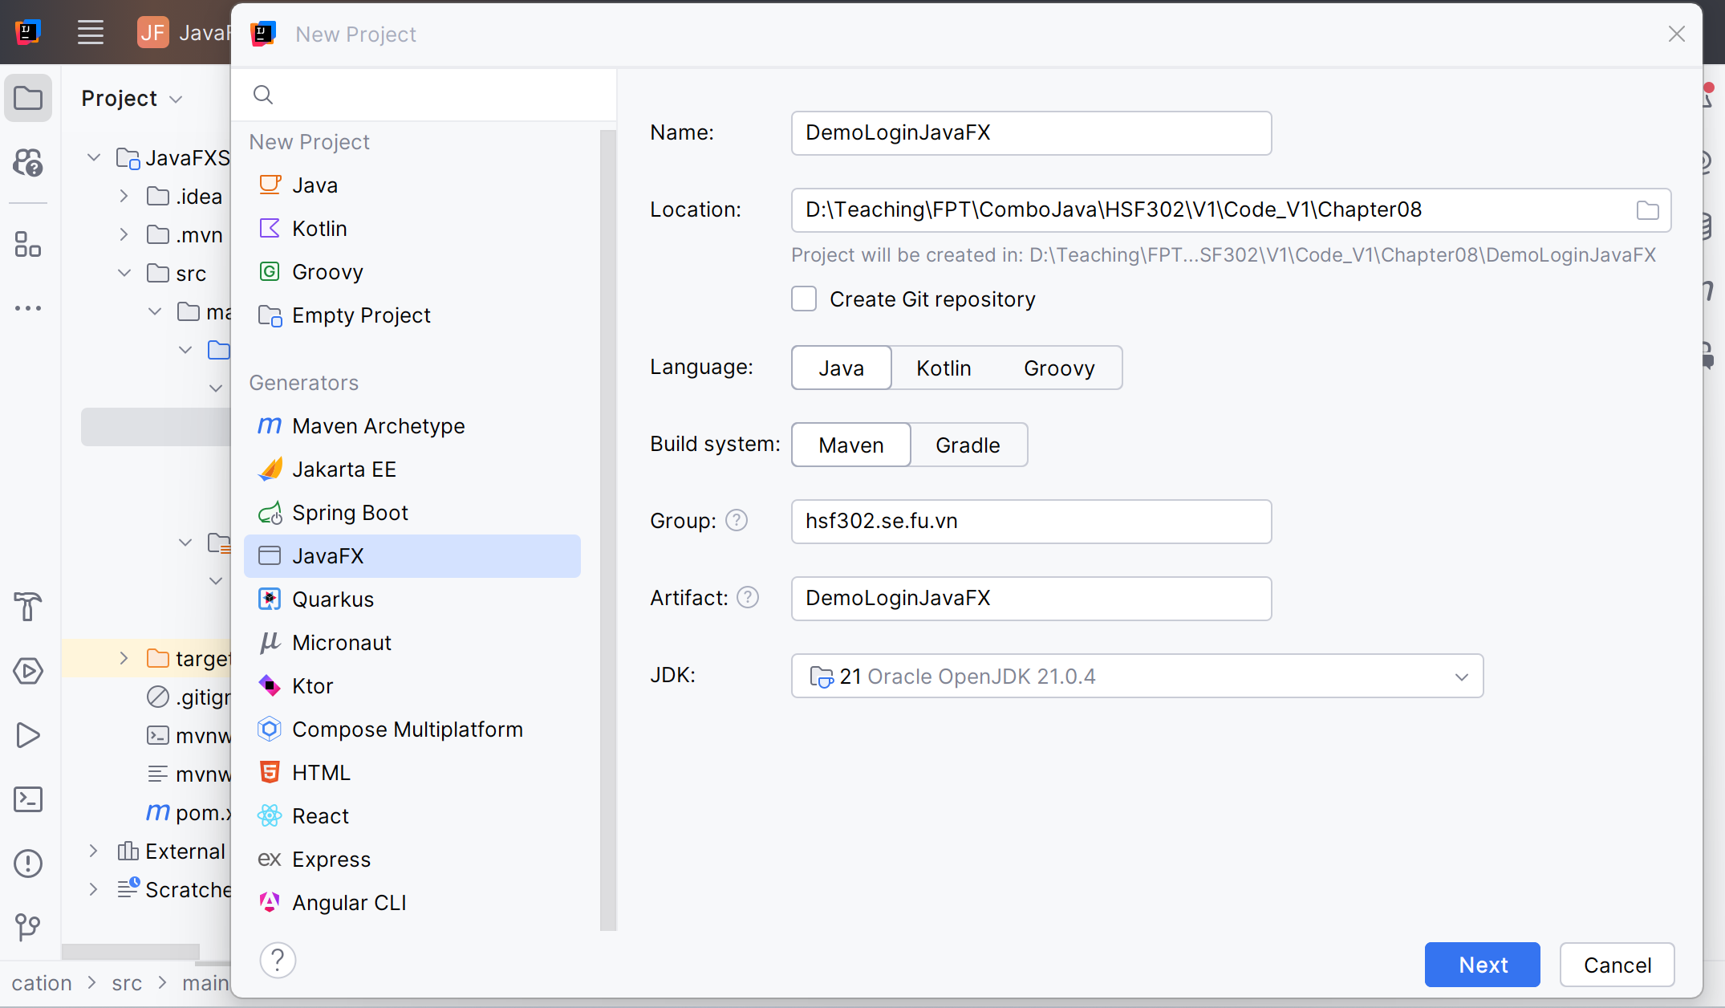
Create JavaFX Simple Application

Slide 64
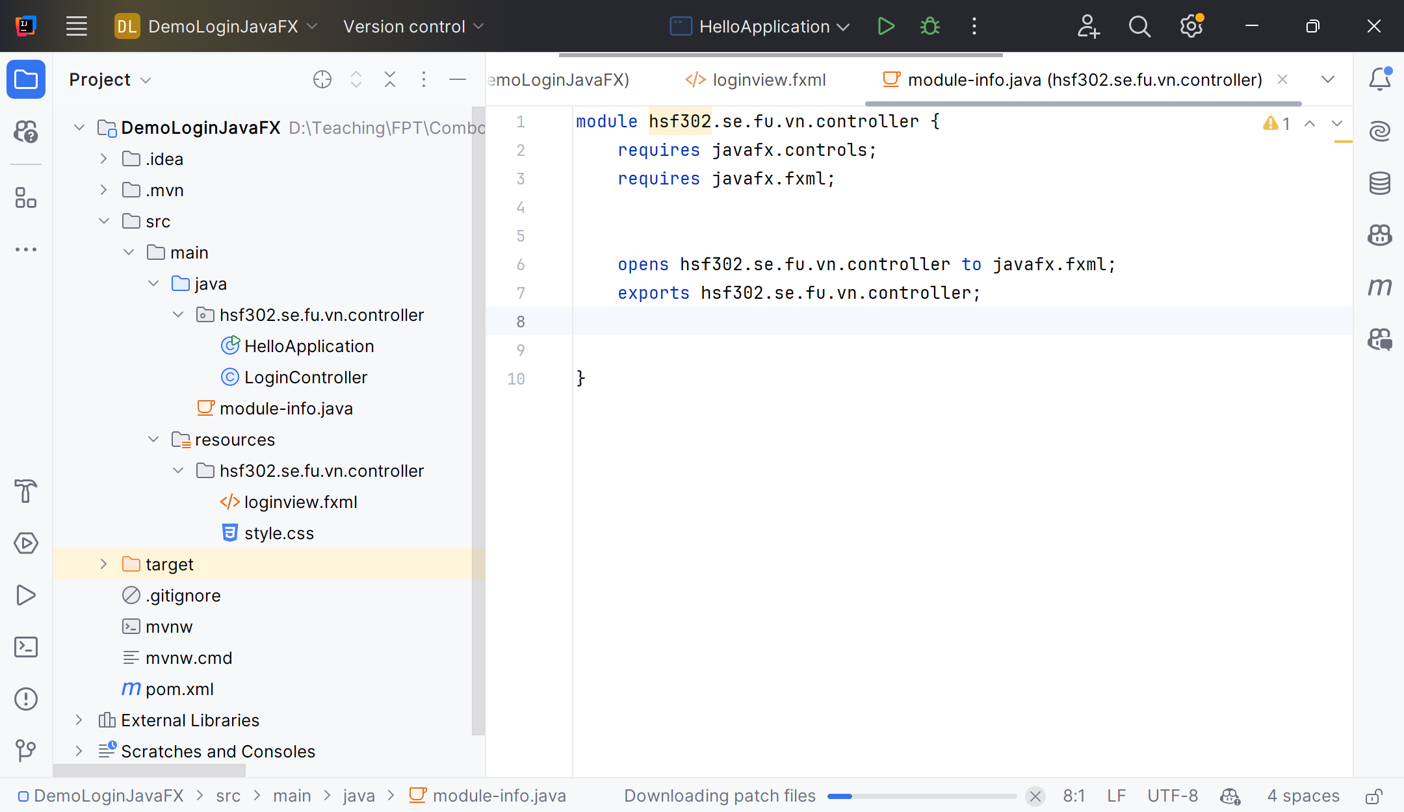
Structure of JavaFX Application

Slide 65
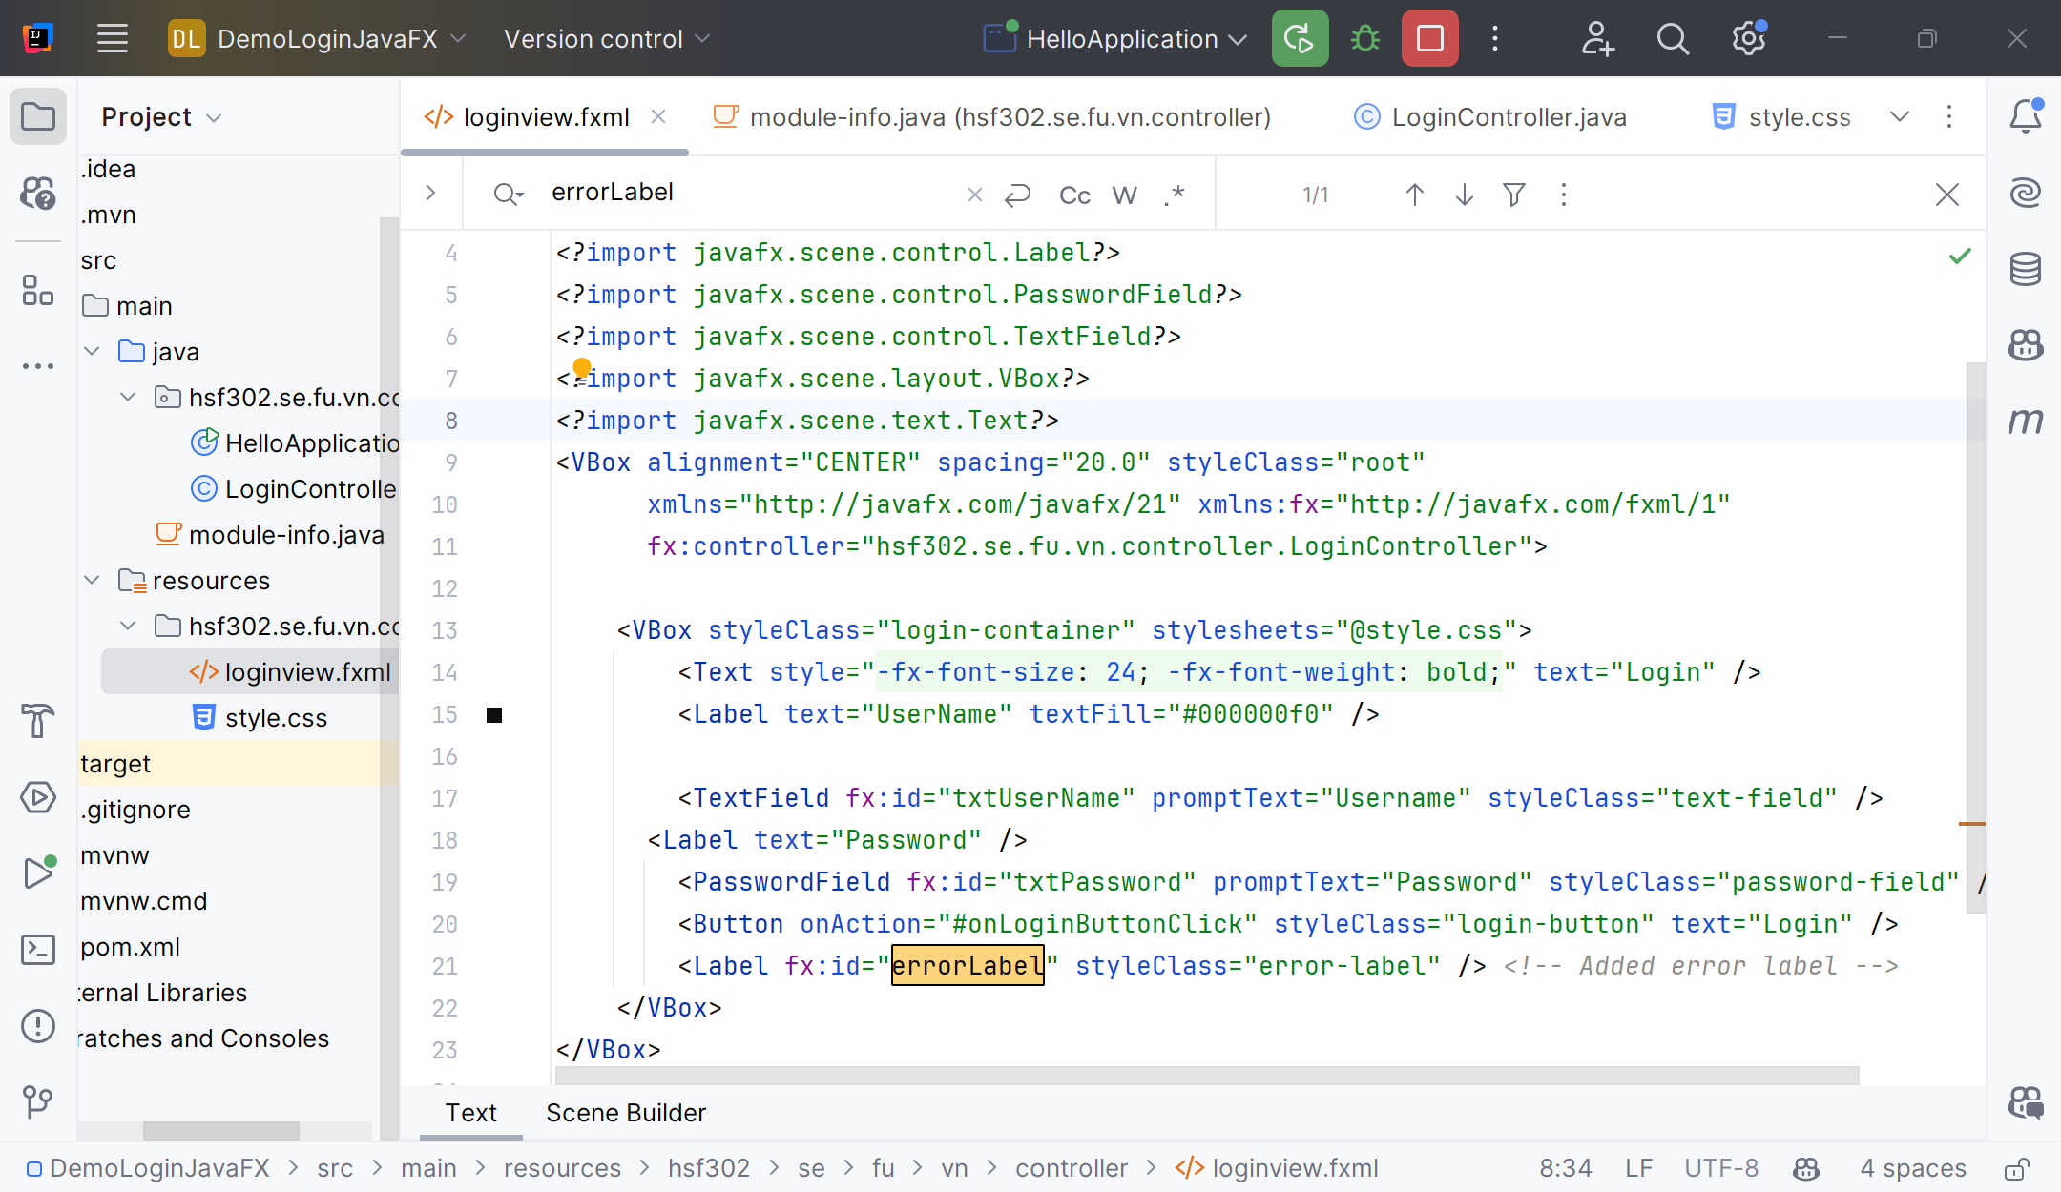
View of JavaFX

Slide 66
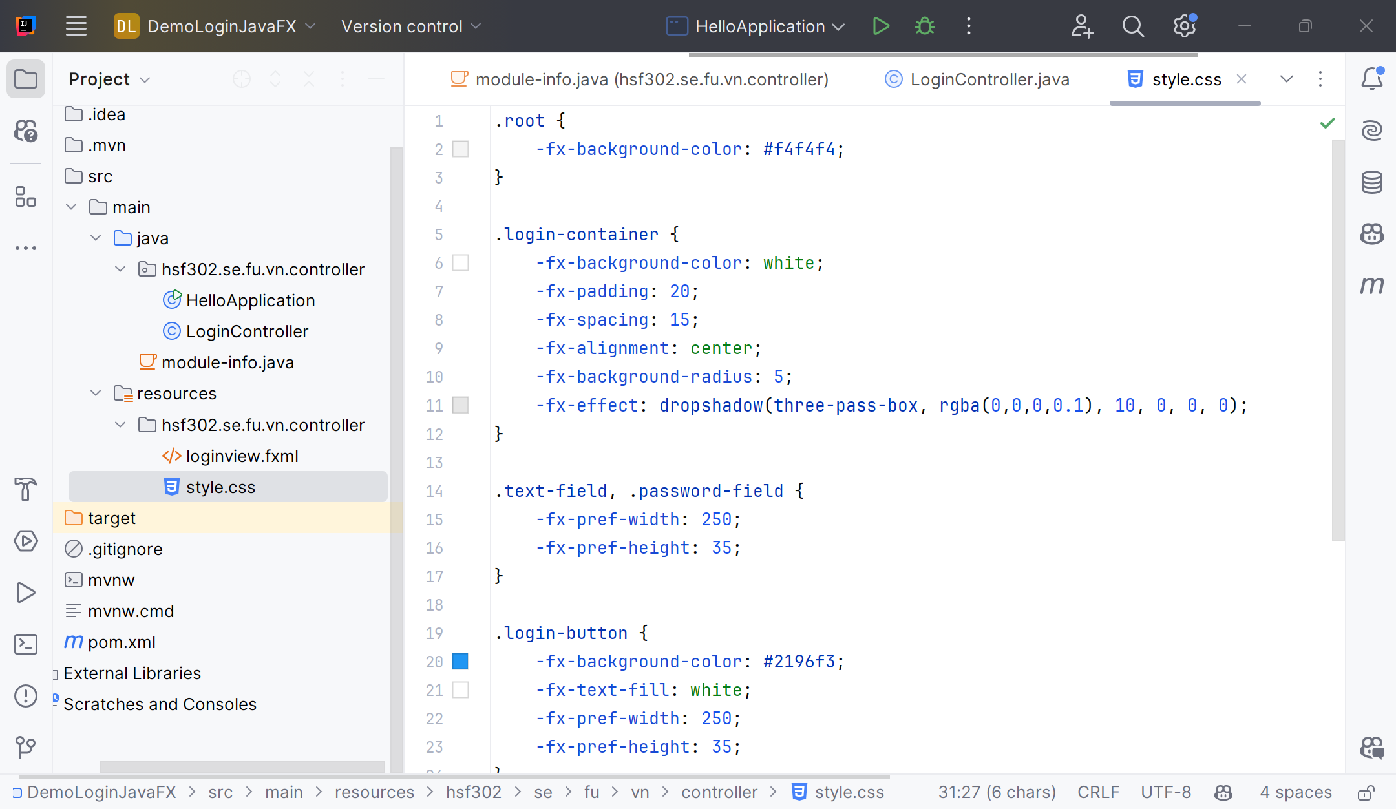
Create the style.css

Slide 67
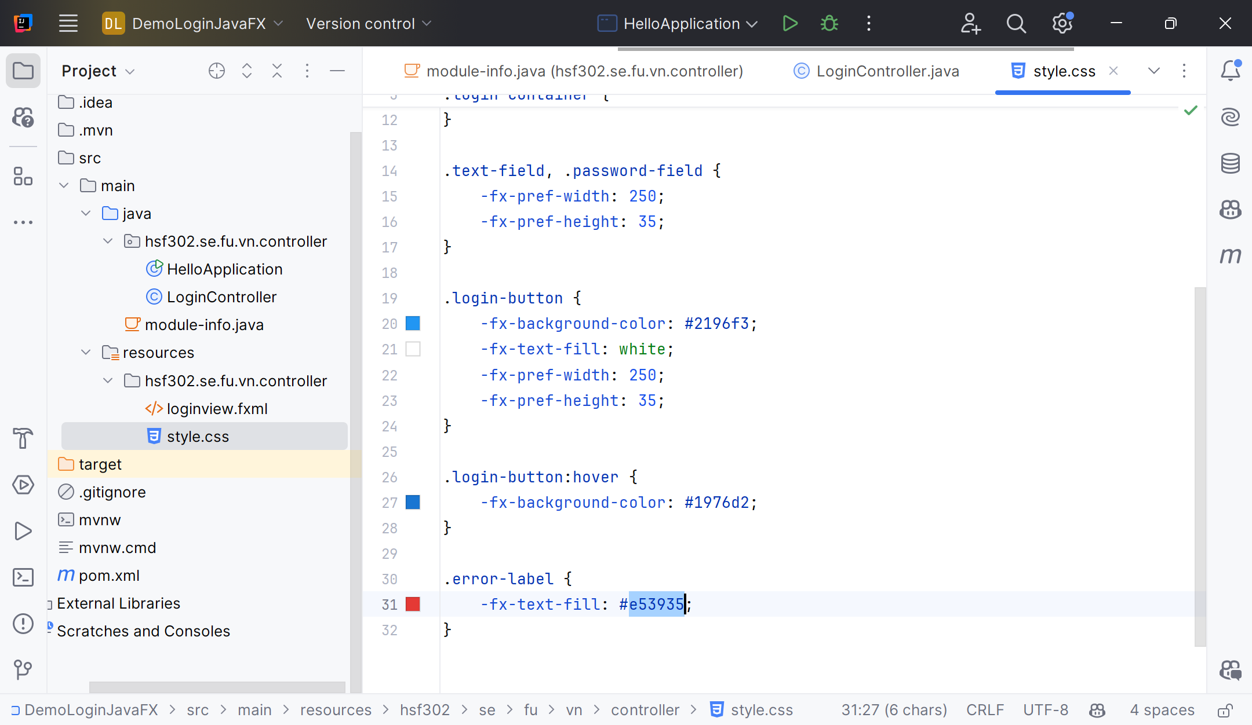
Create the style.css

Slide 68
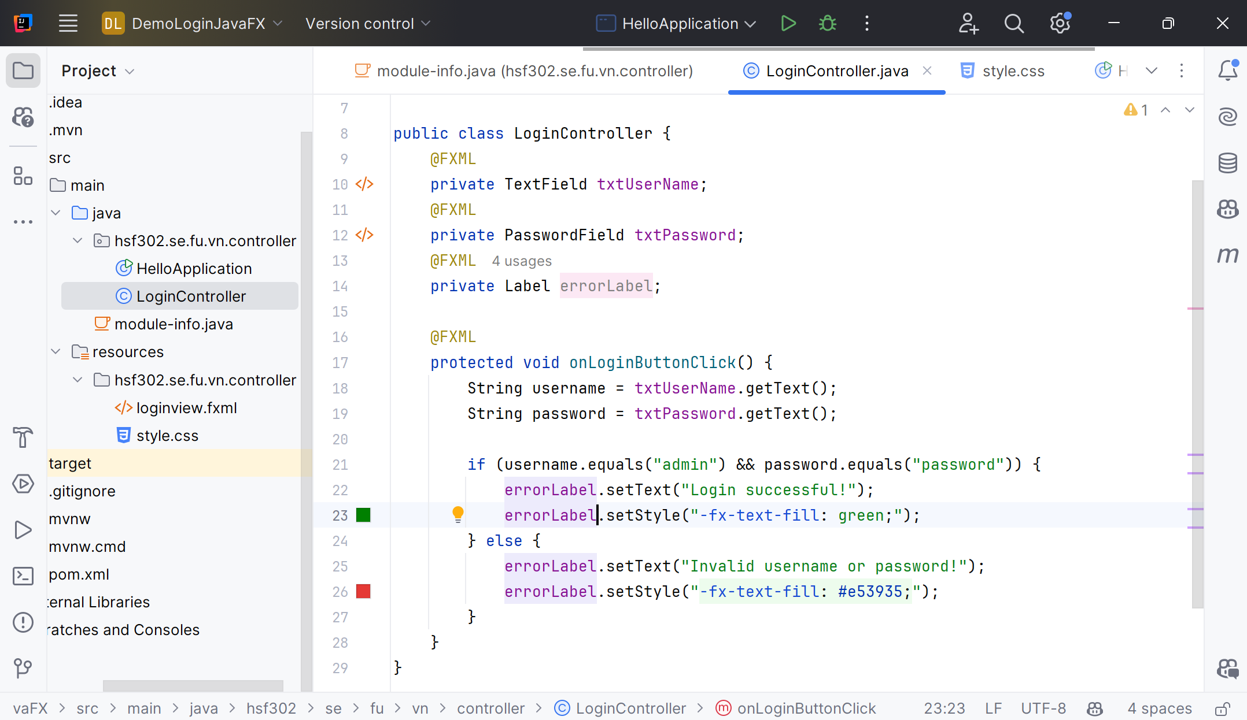
Controller of JavaFX

Slide 69
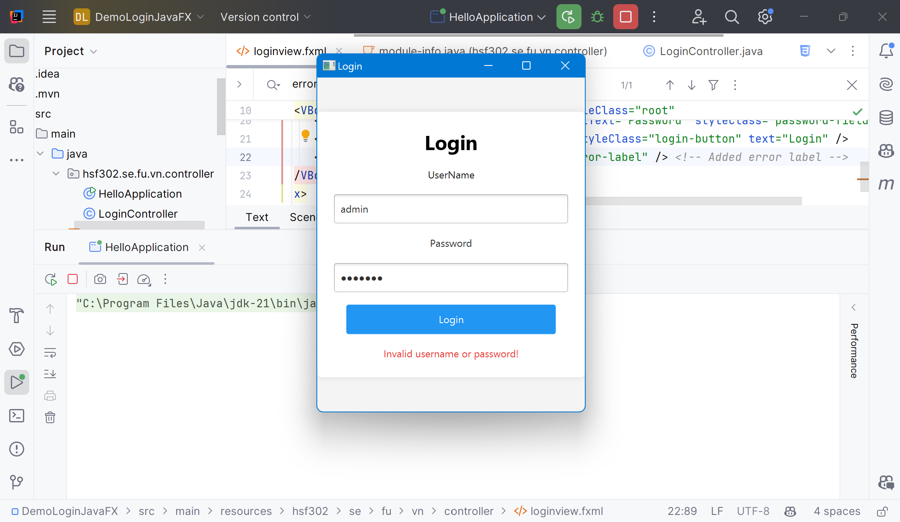
Result

Slide 70
Summary
Concepts were introduced:
JavaFX Architecture
JavaFX Core: Stage, Scene, FXML
Understand JavaFX Properties and Bindings, Events, Layouts, Controls
Create Java desktop applications with JavaFX

